Slide 1
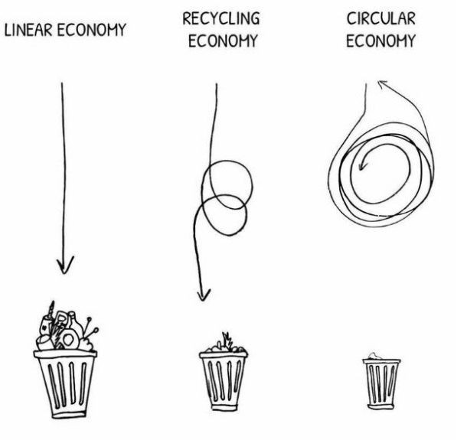
ABI Green Economy - WHAT

Slide 2
ABI Green Economy - WHY

Slide 3
GE Working Group
GE Methodology:
Nodal points
Phased approach
Pilot areas
ABI Alien Clearing Programme managed by Flower Valley Conservation Trust
Akkedisbergpas
Collation of baseline data
How much of what is where?
Further communication to follow

Slide 4
ABI Green Economy - STRATEGY
Via WhatsApp or SMS
073 223 6159 - NOT FOR PHONE CALLS!
During October
Roundtable discussions
12 November
13 November
14 November
6 – 10 people per session
10:00 – 13:00
Venue TBC

Slide 5
BIG HAIRY AUDACIOUS IDEAS
Think-tank

Slide 6
072 382 6712
green@agulhasbiodiversity.co.za

