Slide 1
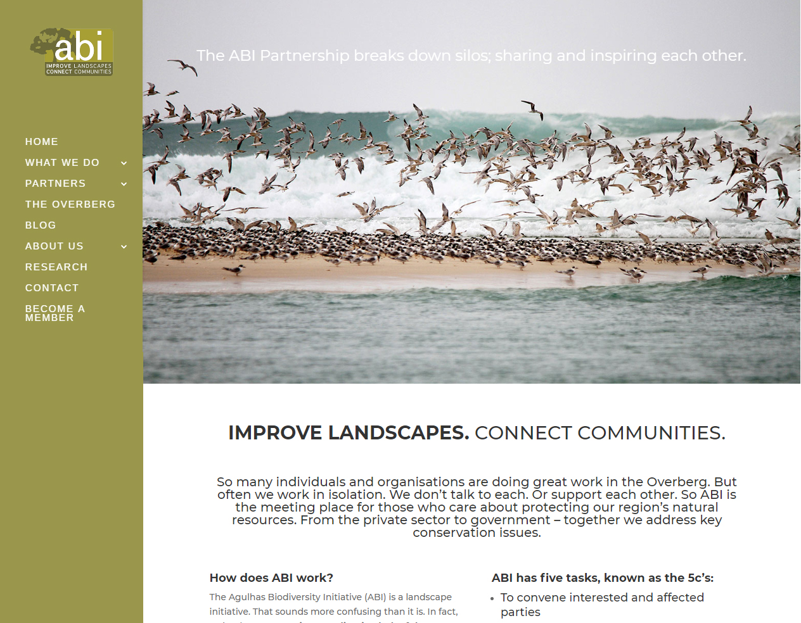
ABI COMMUNICATIONS REPORT 2019
Notes:
So goed wat uitstaan oor laaste jaar:
GREEN ECONOMY
MAPPING
WATER FUND
MEMBER FEATURES
ENVIRONMENTAL GOODIES: Soos FOREST, MPA’s, ANIMALS,

Slide 2
ABI COMMUNICATIONS
OJBECTIVES
BUILD BRAND AWARENESS OF ABI AND ABI PARTNERSHIP
BUILD AWARENESS OF THE OVERBERG’S NATURAL RESOURCE WEALTH
PROFILE ABI PARTNERS TO ENCOURAGE COLLABORATION
PROMOTE ABI AS THE CENTRAL PLATFORM TO HOUSE OVERBERG INFO

Slide 3
ABI COMMUNICATIONS
OJBECTIVES
BUILD BRAND AWARENESS OF ABI AND ABI PARTNERSHIP

Slide 4
ABI COMMUNICATIONS
AUDIENCE OVERVIEW: 1 Sep 2018 – 31 Aug 2019
2018-2019 (12 months)
1741
VISITS
5954
3.42
PAGEVIEWS
PAGES PER VISIT
2.38 min
69 %
TIME ON SITE
BOUNCE RATE
Notes:
Op die visits is ons heelwat af, maar hierdie is nou baie meer in lyn soos dit moet wees, met regte traffic. Die Pageviews lyk baie goed, dis omtrent
dubbeld soveel as laas jaar. Kan duidelik sien mense spandeer lekker lank en check die content uit, ook aangesien die gemiddels 3.42 pages per visit is –
Baie nice.

Slide 5
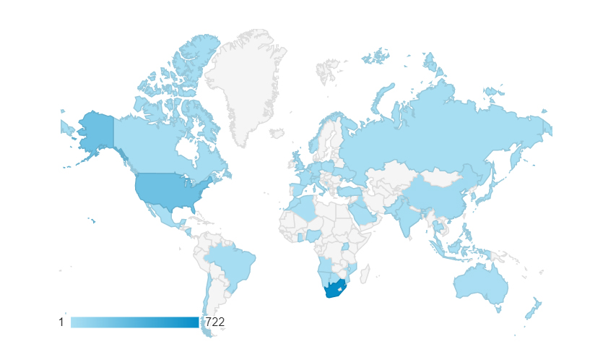
ABI COMMUNICATIONS
AUDIENCE OVERVIEW
2018-2019 (12 months)
GEO LOCATION
COUNTRY
South Africa – 722 visitors
USA – 264 visitors
UK – 38 visitors
France – 20 visitors
Canada – 18 visitors
Notes:
Hierdie lyk goed, lekker sterk SA presence, maar nogsteeds hier en daar international reach

Slide 6
ABI COMMUNICATIONS
AUDIENCE OVERVIEW
RESPONSIVE VIEWS
MOBILE & TABLET
2019 - 36 %
2018 – 10.5 %
2017 – 18 %
2016 - 15 %
2015 - 16 %
2014 - 14 %
Notes:
HUGE increase in mobile views in 2019

Slide 7
ABI COMMUNICATIONS
ACQUISITION OVERVIEW
2019
REFERRAL TRAFFIC (BACKLINKS)
www.facebook.com 257
Notes:
Hierdie groot veranderinge – alles meer in balans. Sien daar is nogsteeds meer spam/ghost traffic as ander kliente, maar baie minder as voorheen! Lekker direct traffic en lekker social media, well done julle! Nie baie backlinks, maar cool dat klomp mense kom vanaf Facebook na ABI site

Slide 8
ABI SOCIAL REPORT
SOCIAL MEDIA PLATFORMS (2018-2019)
FACEBOOK
FOLLOWERS:
1005 (+20 %)
+ 173 new followers
TWITTER
FOLLOWERS:
563 (+6 %)
+ 33 new followers
INSTAGRAM
FOLLOWERS:
546 (+28%)
+ 118 new followers
TOTAL FACEBOOK REACH: 49 136
Notes:
ADRIANNE – sit Facebook total Reach ook by?

Slide 9
ABI COMMUNICATIONS
OTHER ABI FEATURES & EVENTS:
Agulhas National Park – eBulletin
The Nature Conservancy
CapeNature
The Expedition Project
Fynbos Forum
SANBI
Flower Valley
Grootbos Foundation
Overberg Crane Group
Xplorio
CAPE CIC

Slide 10
ABI COMMUNICATIONS
OJBECTIVES
BUILD AWARENESS OF THE OVERBERG’S NATURAL RESOURCE WEALTH

Slide 11
ABI COMMUNICATIONS
ABI FEATURES
Notes:
Hoof blog posts se stats – Forests het BAIE goed gedoen, miskien screenshot insit daarvan?

Slide 12
ABI COMMUNICATIONS
ABI FEATURES
Notes:
Hoof blog posts se stats – Forests het BAIE goed gedoen, miskien screenshot insit daarvan?

Slide 13
ABI COMMUNICATIONS
ABI FEATURES
Notes:
Hoof blog posts se stats – Forests het BAIE goed gedoen, miskien screenshot insit daarvan?

Slide 14
ABI COMMUNICATIONS
OJBECTIVES
PROFILE ABI PARTNERS TO ENCOURAGE COLLABORATION

Slide 15
WEBSITE
FUNCTIONALITY:
Member feature
Notes:
Watter nuwe members het ons almal gefeature: Overstrand Muni, Grootbos Foundation, Carla

Slide 16
ABI INSTAGRAM TAKEOVER
Notes:
ADRIANNE

Slide 17
ABI COMMUNICATIONS
OJBECTIVES
PROMOTE ABI AS THE CENTRAL PLATFORM TO HOUSE OVERBERG INFO

Slide 18
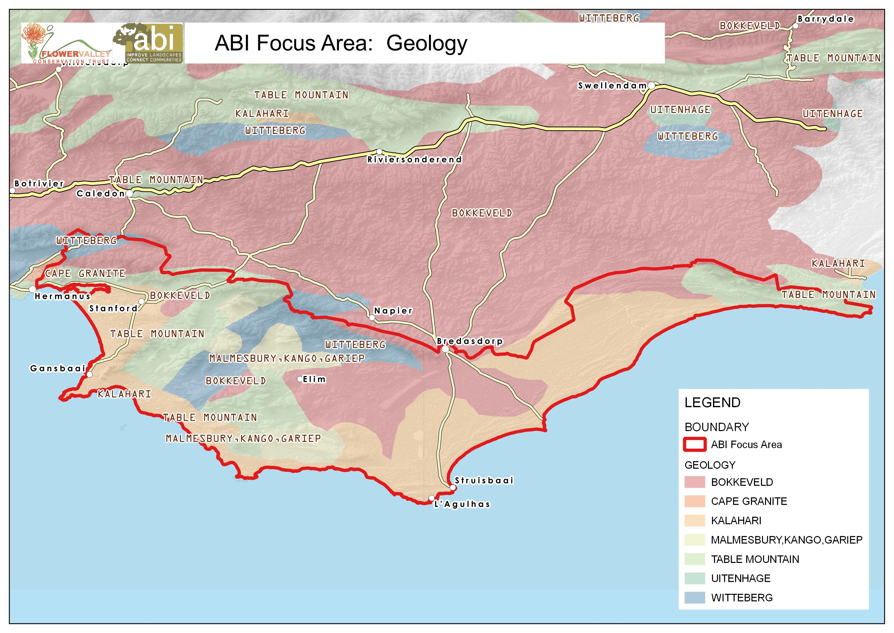
ABI COMMUNICATIONS

Slide 19
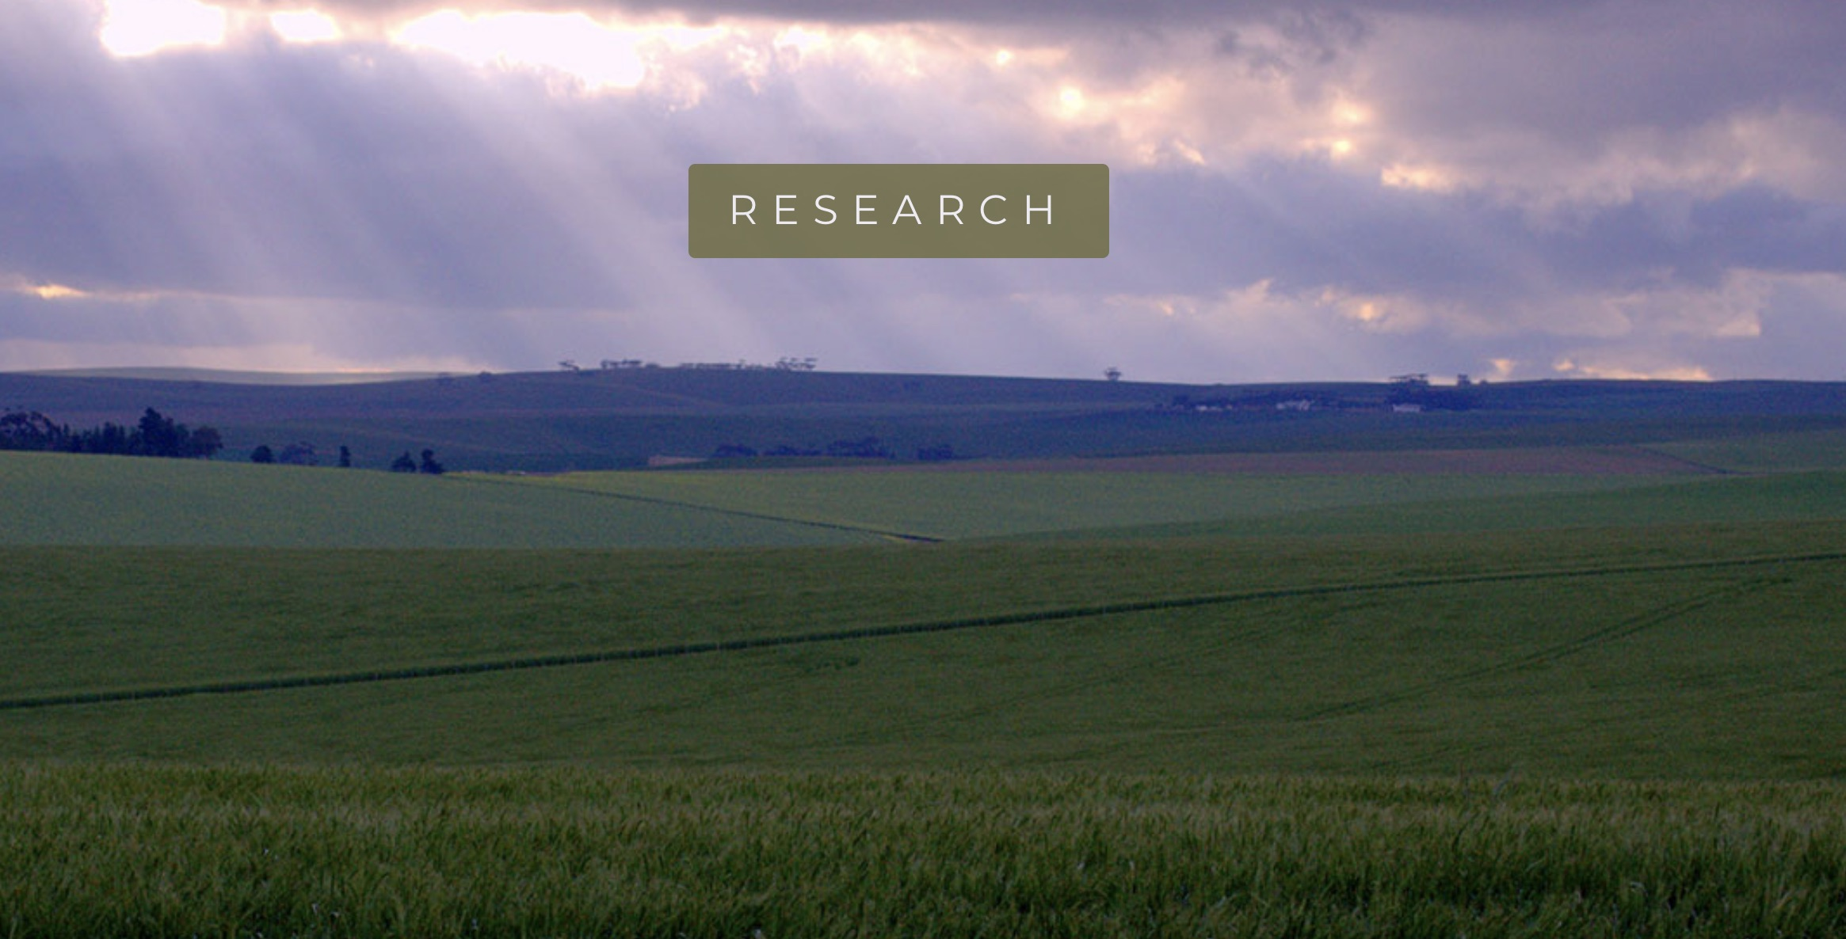
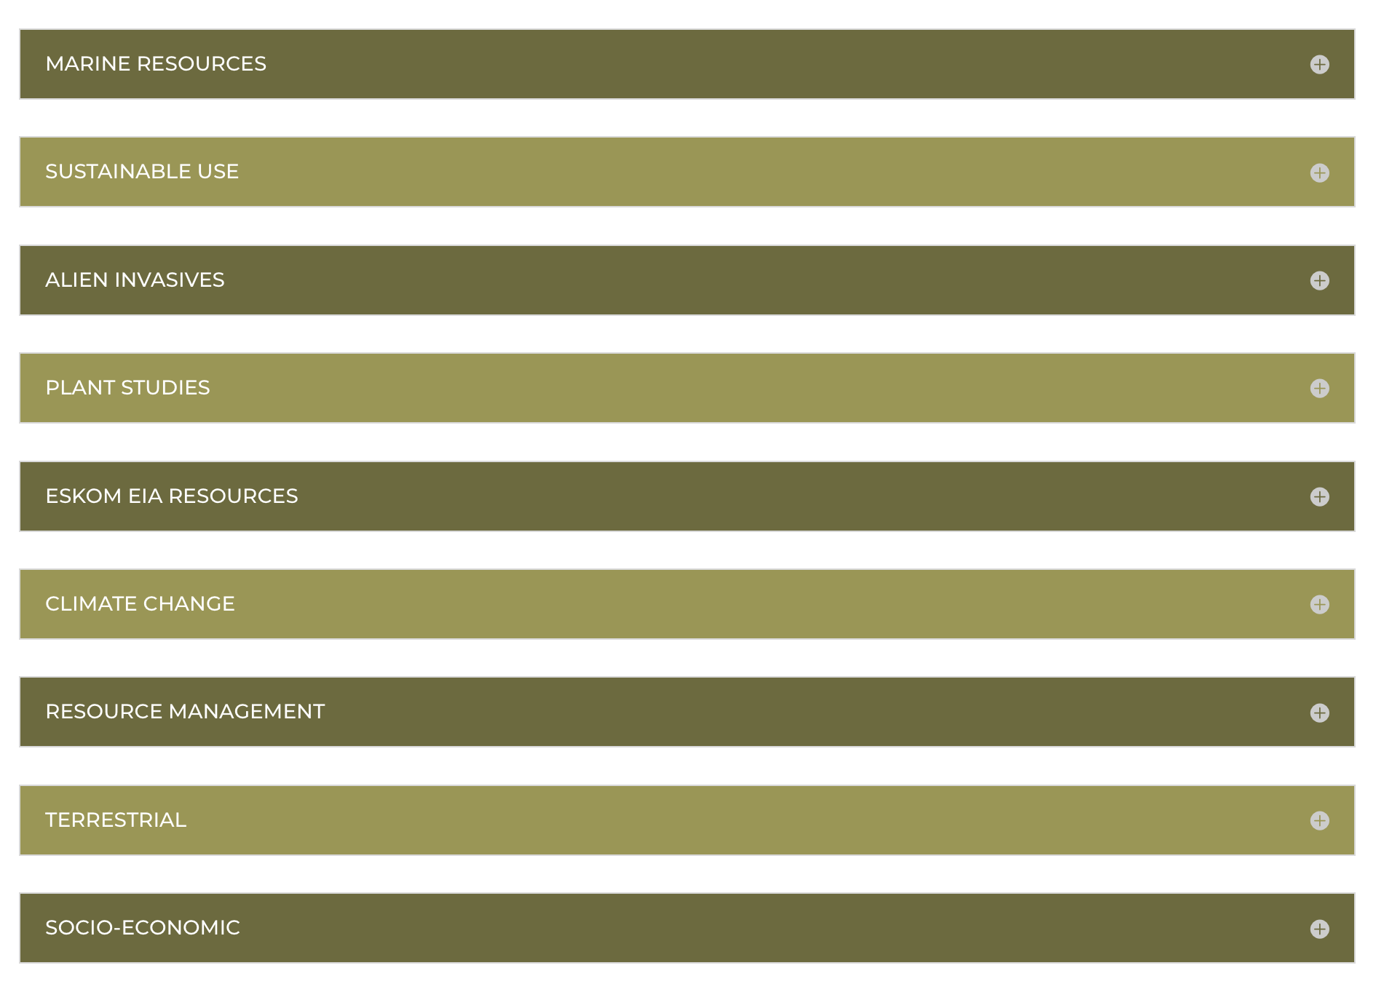
ABI COMMUNICATIONS

Slide 20
ABI FEEDBACK SURVEY
WHAT YOU WANTED
SMALLER WORK GROUP SESSIONS
MORE INFO ON FUNDING OPPORTUNITIES
MEET MORE REGULARLY THAN 3 TIMES A YEAR
BOOKLET PRINTED WITH CONTACT INFO, MAPS AND STORIES
LAUNCH A VIDEO BLOG TO SHARE ON SOCIAL MEDIA
Notes:
Hoof blog posts se stats – Forests het BAIE goed gedoen, miskien screenshot insit daarvan?

Slide 21
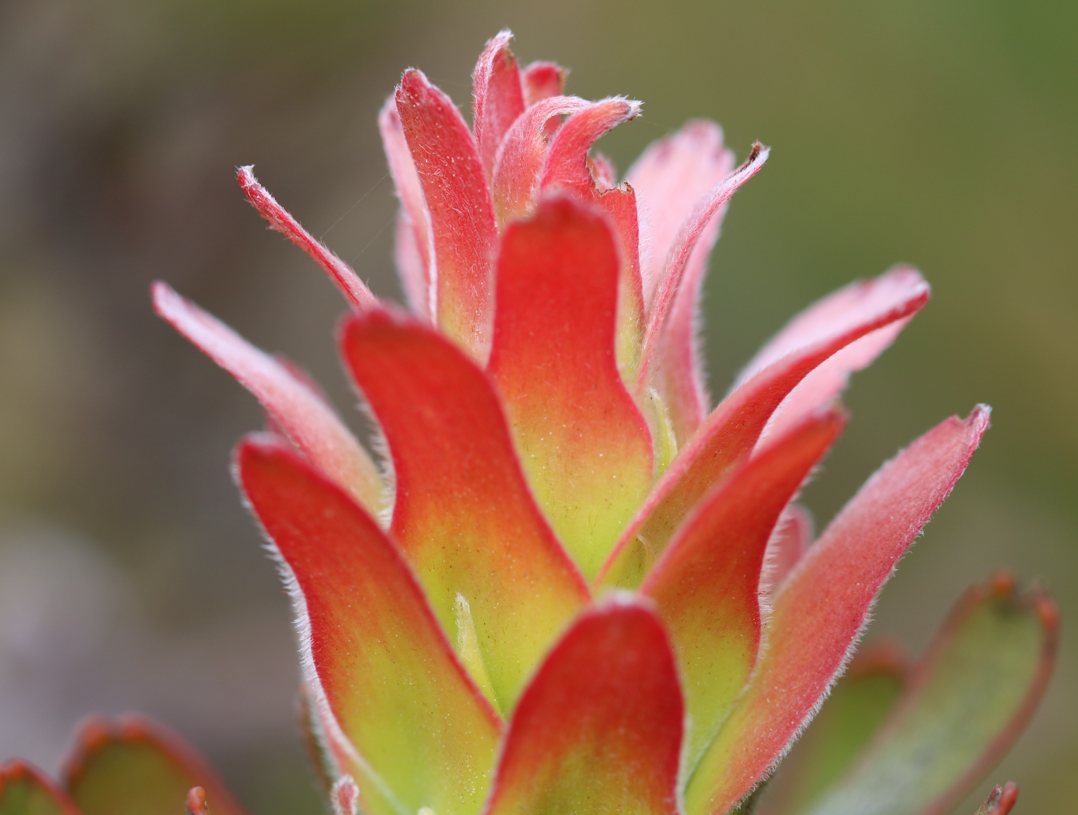
THANK YOU
www.agulhasbiodiversity.co.za

