Slide 1
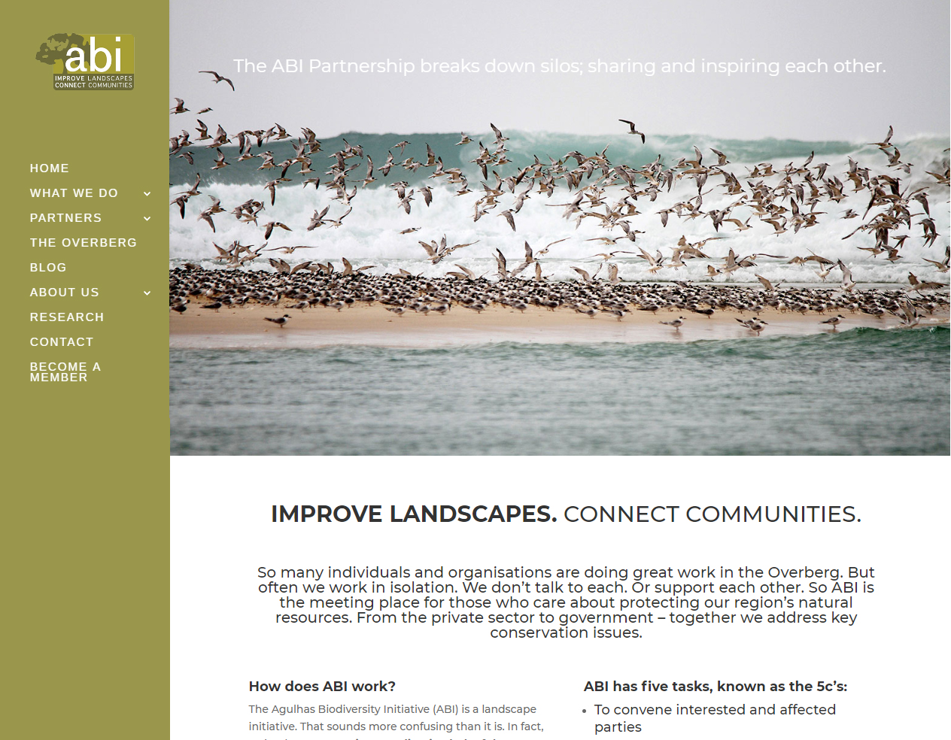
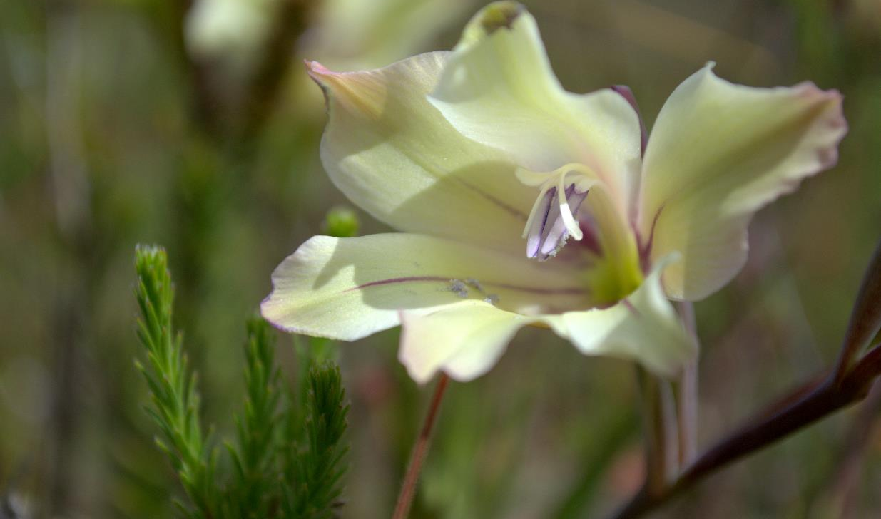
ABI COMMUNICATIONS REPORT 2020

Slide 2
ABI COMMUNICATIONS
OJBECTIVES
BUILD BRAND AWARENESS OF ABI AND ABI PARTNERSHIP
BUILD AWARENESS OF THE OVERBERG’S NATURAL RESOURCE WEALTH
PROFILE ABI PARTNERS TO ENCOURAGE COLLABORATION
PROMOTE ABI AS THE CENTRAL PLATFORM TO HOUSE OVERBERG INFO

Slide 3
ABI COMMUNICATIONS
AUDIENCE OVERVIEW: 1 Nov 2019 – 31 Oct 2020
2019-2020 (12 months)
1348 (+4%)
VISITS
3314
1.86
PAGEVIEWS
PAGES PER VISIT
1.57 min
71 %
TIME ON SITE
BOUNCE RATE

Slide 4
ABI SOCIAL REPORT
SOCIAL MEDIA PLATFORMS (2019-2020)
FACEBOOK
FOLLOWERS:
1136 (+13 %)
+ 131 new followers
TWITTER
FOLLOWERS:
601 (+7 %)
+ 38 new followers
INSTAGRAM
FOLLOWERS:
715 (+31%)
+ 169 new followers
TOTAL FACEBOOK REACH: 28 313
NEWSLETTER REACH: 1 240

Slide 5
ABI COMMUNICATIONS
OTHER ABI FEATURES / CAMPAIGNS
REVISIONING ROLL-OUT: Connect with WWF, rolling out revisioning steps, workshops (Fynbos Forum & other)
PARTNER FOCUS: MEMBER OF THE MONTH
GREEN ECONOMY: WOOD / PELLETS
MEDIA: Work with WWF SA, Alien clearing, CAPE newsletters etc
INSTAGRAM Takeovers
CAPE LEGACY

