Slide 1
Agulhas Biodiversity Initiative (ABI)
Towards a Biosphere Reserve model..?

Slide 2
Opportunities
Become part of a global network of +727 BRs
World Network of Island and Coastal BRs (WNICBR)
UNESCO – BRs and World
Heritage sites carry
considerable status
Limited direct funding…
Significant connections which can facilitate international partnerships

Slide 3
Opportunities
Grow what you are good at…
“Responsible or nature-based tourism
Environmental education, skills and awareness, and
Fostering a green economy”
- ABI website
All key priority elements for BRs

Slide 4
Opportunities
NB: ABI focus is to “improve landscapes”
Biosphere Reserves are, primarily, landscape scale initiatives…
ABI’s DNA aligns with BR principles
Internationally recognised core, buffer and transitional areas…
Elegant solution to land and ocean management
Marine environment – BRs can significantly improve management of coastal and marine resources

Slide 5
Opportunities
Governance
ABI – currently a non-profit association…?
To a S21 company – i.e. an NPC with members
Financial model
Donor funding v business development
Hybrid – both donor-funded projects and value-added industries (products and services)

Slide 6
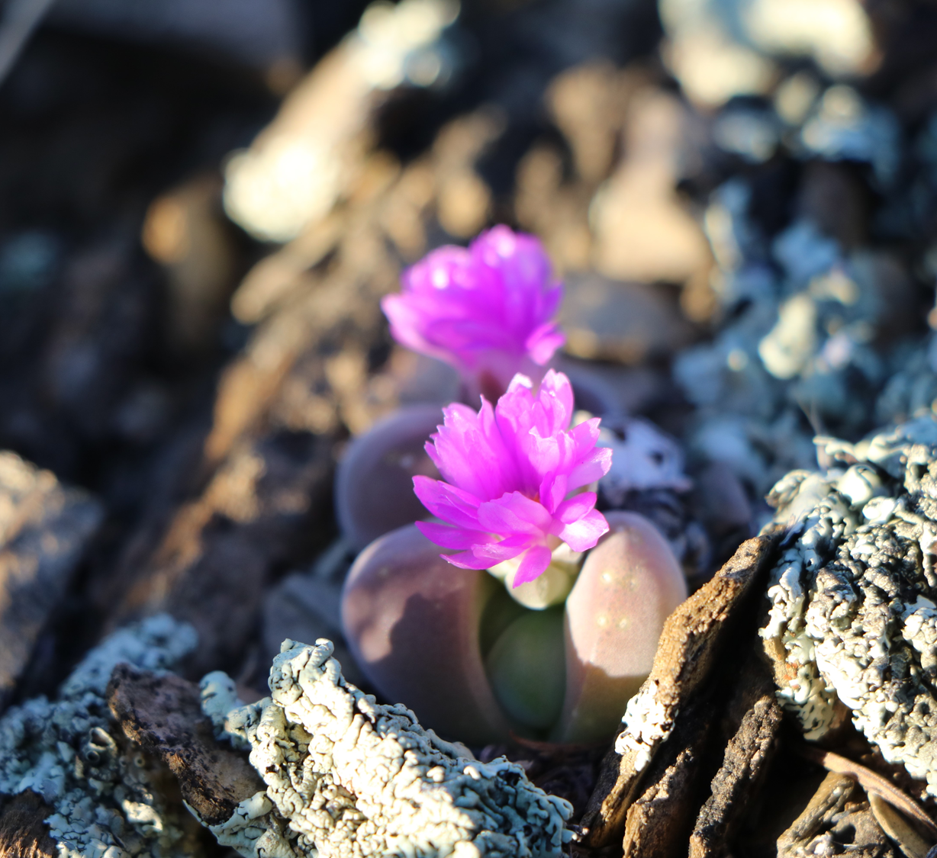
Challenges
Increasingly complex nomination procedure..?

