Slide 1
Green Business Value Chain
Clear to Grow Programme: Overberg

Slide 2
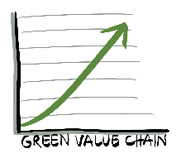
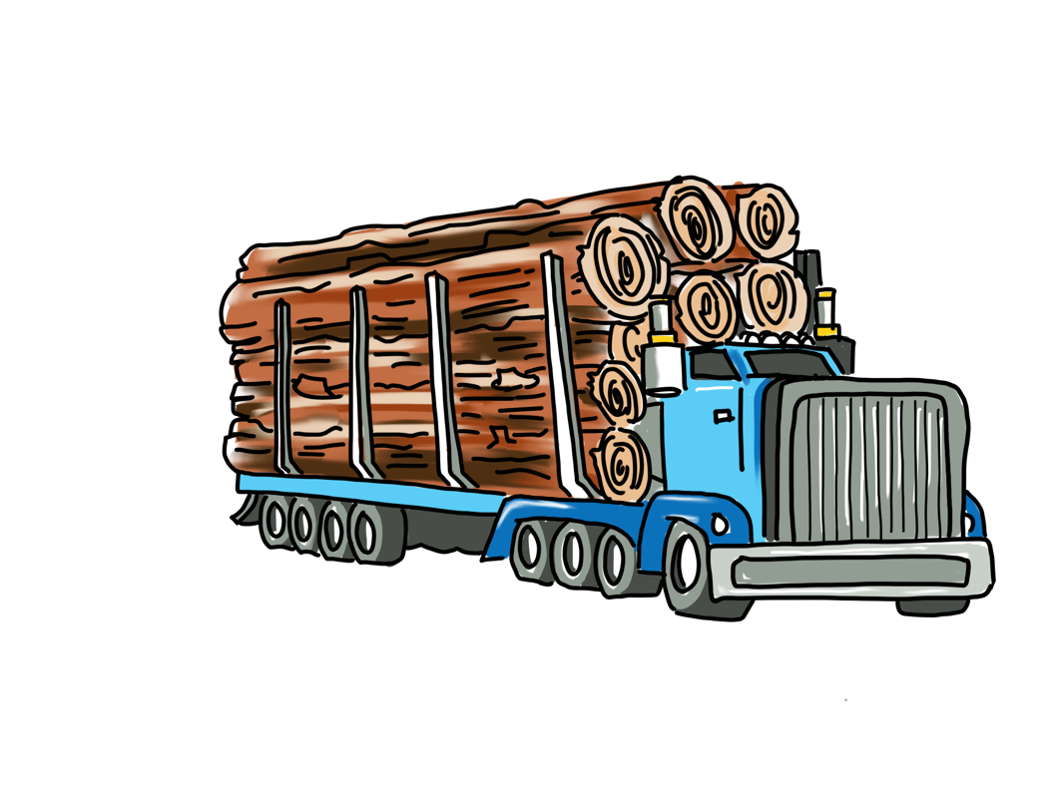
The Clear to Grow Programme will:
Catalyse a strong Biomass Economy…
…by stimulating demand for invasive biomass as an input into value-adding processes, that will..
…accelerate the eradication of invasive biomass…
…enhancing utilisation of and growth potential for SMME’s engaged in the Green Value Chain…
Fire Risk
…and driving clear understanding of roles and responsibilities, and contributions of public and private sector
Water security
And therefore Strengthen South Africa’s water security and reduce fire risk

Slide 3
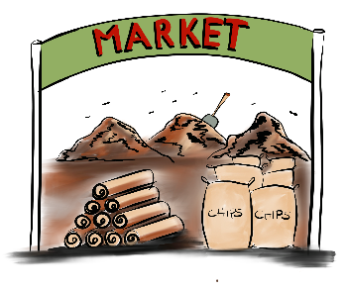
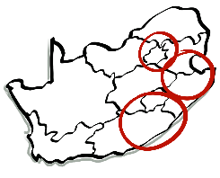
GBVC - Theory of Change
Inputs
Activities
Outputs
Outcomes
Impact
Knowledge
Value Chain
Compost & Coal
Timber, fibre, wood pulp
Knowledge, expertise and R&D
Invasive vegetation value chain mapping
Biomass economy & carbon off-set
Bio-fuels
Sustainable supply chain
Economic value chains
Corporate Talent and Innovation
Brains & Investment
Unblocked supply chain
Value chain simulation
Small Business
Development
Local SMMEs
Training & Mentorship
Sustainable SMMEs
Land user take-off agreements
SMMEs in vertical & horizontal supply chains
Procurement process (portal)
Sustainable livelihoods
Market for invasive vegetation biomass
Invasive Biomass Value Chain
High value invasive vegetation
Invasive vegetation clearing
Ecological Value Chain
Fire Risk
3 Catchment areas
Natural area restoring
Restored ecological services
Virtuous ecological cycle
Water security
Copyright © Avocado Vision (Pty) Ltd 2017

Slide 4
Clear to Grow business development programme for WFW contractors
Business Acumen Simulation part 1
2 days
Business Fit workshop
Open Day
1 day
Mind set : The Anchor Client Model
Financial literacy
3 days
Link to new Opportunities
Business acumen Gearing for Growth
3 days
Recruitment and selection; Audition your Business
Contextual Business support and mentorship

Slide 5
Multi-faceted support
Mentorship programme
Key principle: Owner remains accountable and involved in financial process
Peer Mentorship Process: quarterly meetings
Senior Mentor – sessions booked when needed (Mindset)
Monthly Bookkeeper; Quarterly Accountant (Financial)
Planned – currently unfunded
Financial Coach refresher sessions where needed

Slide 6
Value Chain Overview
Restoring the Ecological Value Chain
Characterise Biomass
Clear & Eradicate
Secure Biomass Offtake
Contracting / Takeoff
Rehabilitate
Biomass
Harvesting
Ecological Restoration
& Silviculture
On-Site Value Add
Logistics
Off-site Value Add
Demand Links / Markets
Building the Economic Value Chain

Slide 7
Working session
Afternoon

Slide 8
Agenda
Revisit the Theory of Change
Objectives for uMzimvubu ‘First 15’ Pilot
Recruiting details
Criteria
Recommendations
Logistics
Programme execution:
how shall we collaborate?
Where best to locate training sessions?
What practical local support shall we put in place?

Slide 9
GBVC - Theory of Change
Inputs
Activities
Outputs
Outcomes
Impact
Knowledge
Value Chain
Compost & Coal
Timber, fibre, wood pulp
Knowledge, expertise and R&D
Invasive vegetation value chain mapping
Biomass economy & carbon off-set
Bio-fuels
Sustainable supply chain
Economic value chains
Corporate Talent and Innovation
Brains & Investment
Unblocked supply chain
Value chain simulation
Small Business
Development
Local SMMEs
Training & Mentorship
Sustainable SMMEs
Land user take-off agreements
SMMEs in vertical & horizontal supply chains
Procurement process (portal)
Sustainable livelihoods
Market for invasive vegetation biomass
Invasive Biomass Value Chain
High value invasive vegetation
Invasive vegetation clearing
Ecological Value Chain
Fire Risk
3 Catchment areas
Natural area restoring
Restored ecological services
Virtuous ecological cycle
Water security
Copyright © Avocado Vision (Pty) Ltd 2017

Slide 10
Application and Selection Process
Nomination and recommendation by NRM/EPWP/Working for Water Implementing agent
Application submitted online
Option of a Video/written motivation about why they’re an ideal candidate for this programme
Audition your business: Workshop and present to panel

Slide 11
Application process diagram
Nomination
You are nominated by a GBVC partner
Round 1:Applicant Registration
register to apply on the online Social Collective platform
Round 2: Application submission
complete the online application form
upload a short mobile video telling us why you think you should be selected for this programme (maximum 1 minute long)
Round 3: Final Selection presentation
Successful applicants who make it through Round 2 will present to the final selection panel. The final 20 will be chosen to attend the development programme.

Slide 12
Proposed Selection Criteria
Minimum 3 years’ experience in running Alien Clearing (or invasive biomass; eco-rangers; wetland restoration) contracting company within the NRM supply chain: existing supplier
Recommendation from NRM or Implementing Agents as to commitment; responsibility; customer management, resilience and business ethics
Experience in managing at least 5 employees
Company has some assets: Truck, clearing equipment etc
People with that ‘special something’ – just need a leg up and will make the opportunity work
Instinct and propensity to grow their business and adapt to new opportunities: evidence of innovation around expanding their operations would be a plus, even if not successful (eg – cut and sell firewood from Alien Biomass; seeking new customers for clearing activities; attempts at value-added activities)
Preferably with limited credit score issues – at least with the possibility of short term rehabilitation. Severe ‘debt holes’ would hamper external investment in their company should that be needed for growth
Black women under 35 will be given priority access in support of the Fempowerment programme
For the extra 10 seats on the programme that Nicky McLeod requested, we will apply as many of the above criteria as possible, but rely more heavily on your motivations for people who don’t meet the criteria but would really benefit from the opportunity to attend.

Slide 13
A year in the life of the Contractor…
Recruit and Select
1-year training programme (9 days, mentorship)
Link to new opportunities; offtakes
Financier support
Secure offtake
Good credit score
Financial Management support and reporting
Strong feasibility
Supplier Developent with new customer
Technical upskilling?
Programme management?
Local support?
Recruit
Consolidate business skills
New markets, clients
Tool up: Financial Resouces
Growth
Significant capital outlay

Slide 14
Workshop
What risks and challenges do we foresee?
How can we give the contractors the best chance of success?
What local networks can we access for
New markets?
Offtake agreements
New oportunties
How can we work together to achieve the best outcome?
Tentative recommendations for participants?
How can this network contribute?

Slide 15
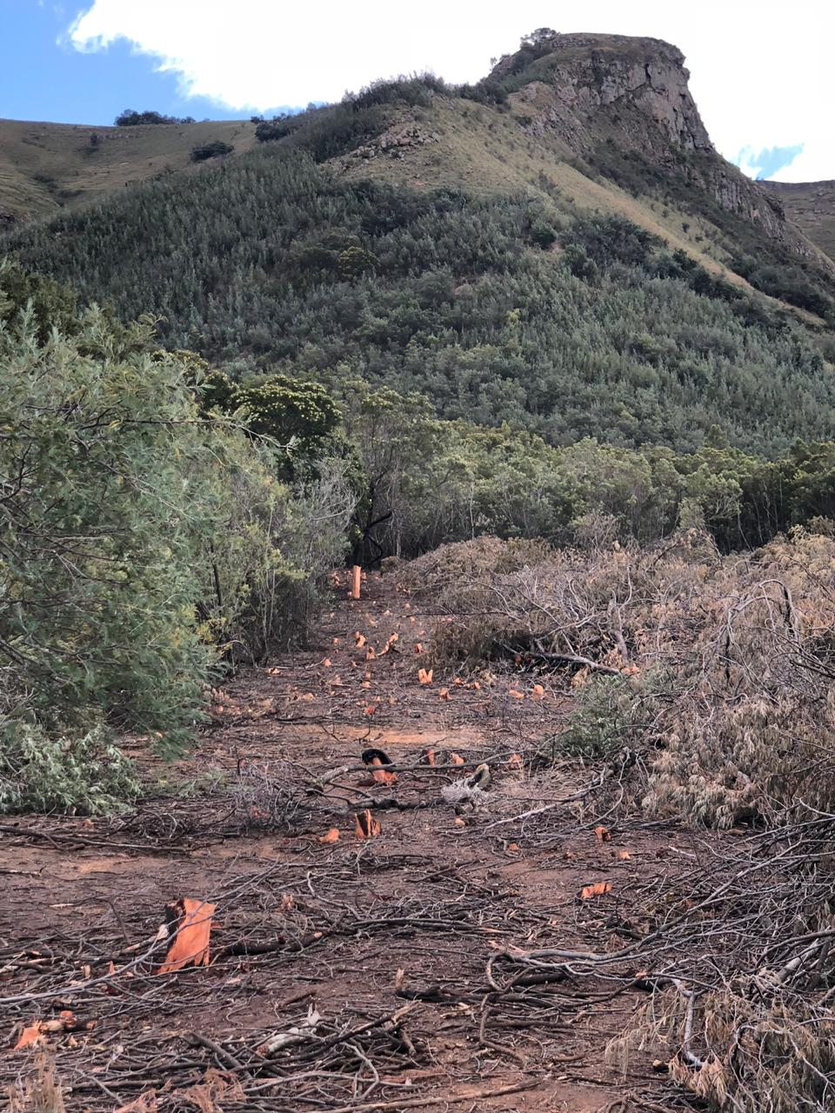
Value Chain process: Initial Analysis
Invasive & Alien Plant (IAP) coverage and densities
Rehabilitation requirements

Slide 16
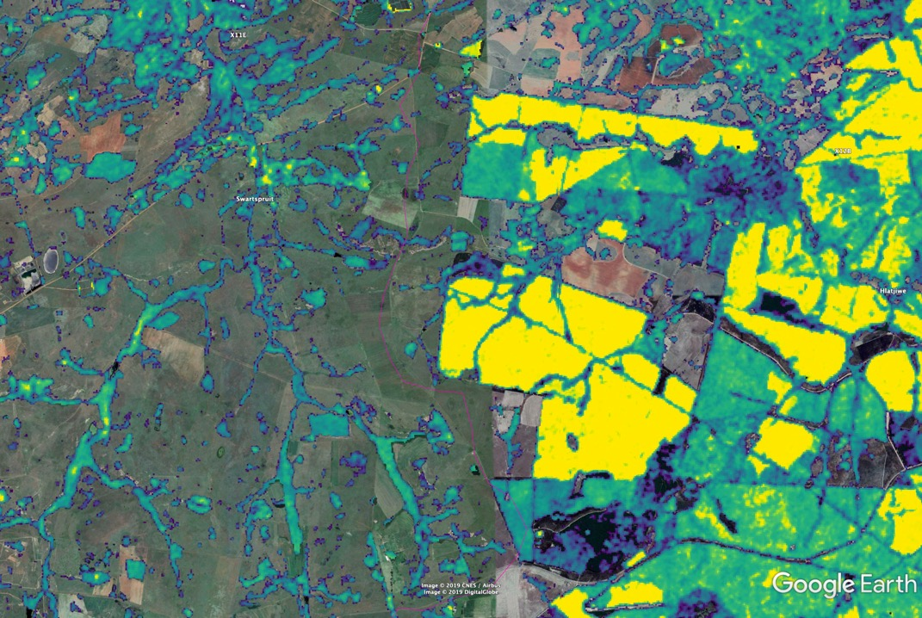

Slide 17
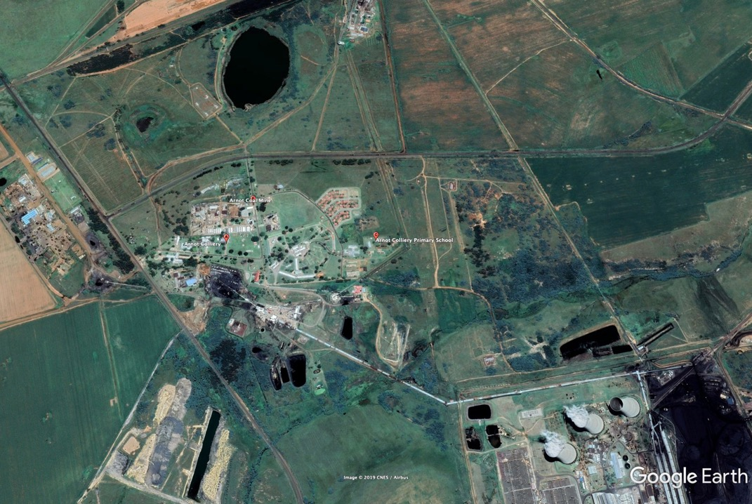

Slide 18
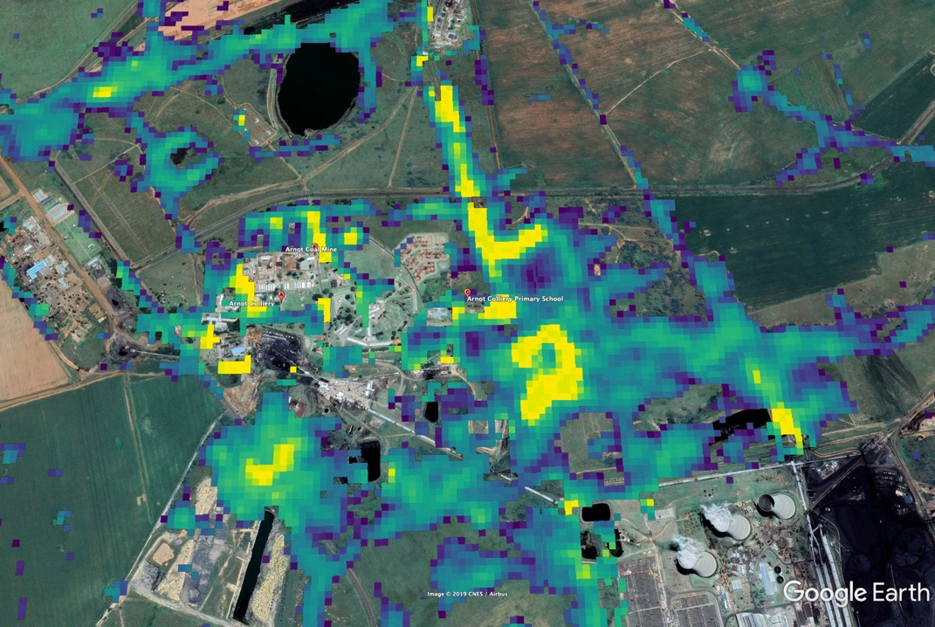

Slide 19
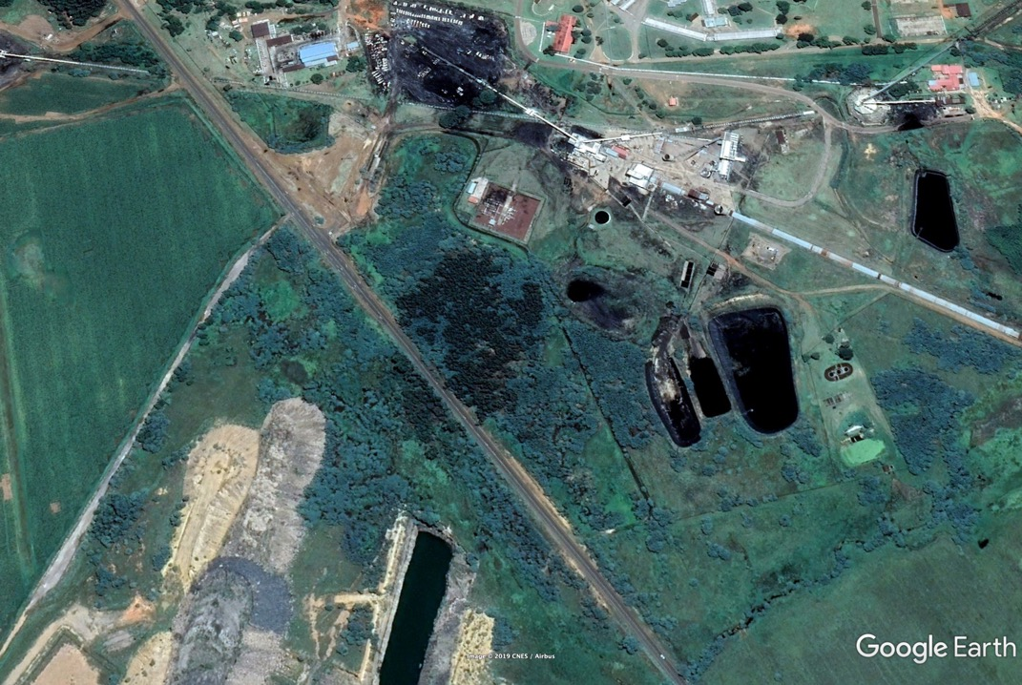

Slide 20
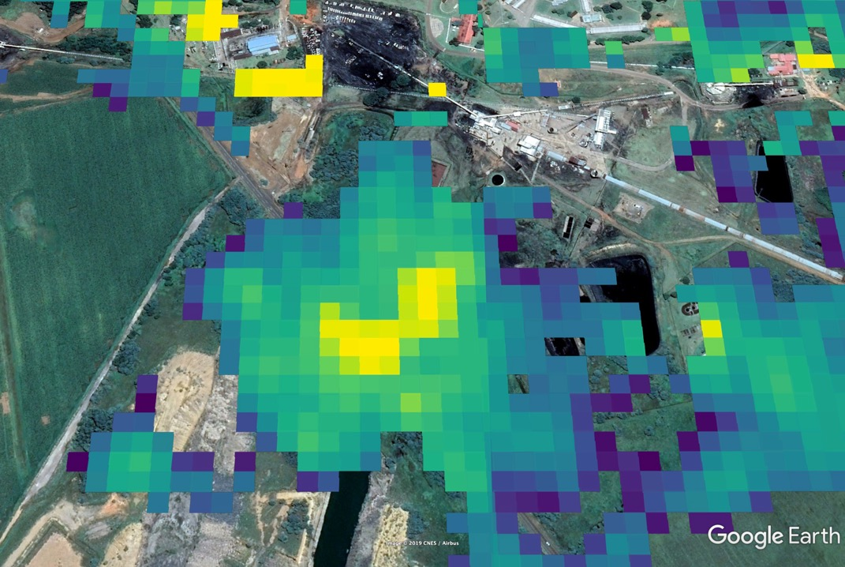

Slide 21
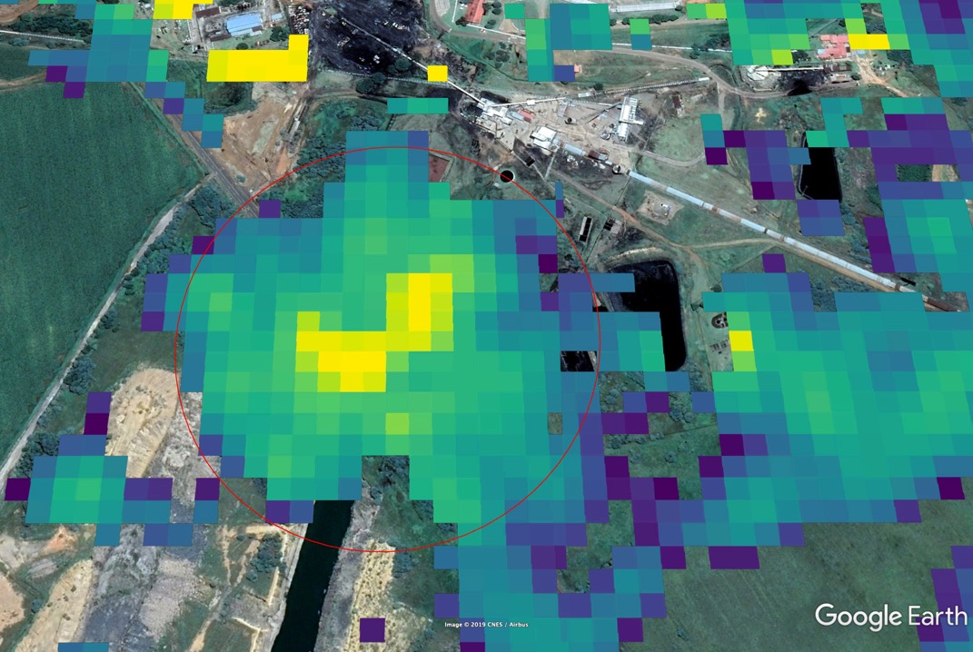
20 Ha @
average of 50 tons /Ha
= 1 000 tons biomass

Slide 22
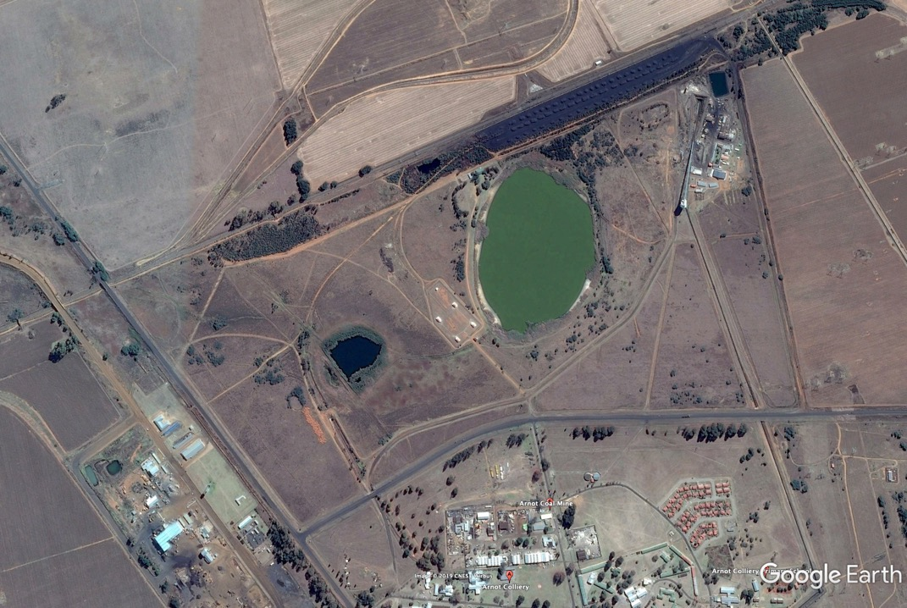

Slide 23
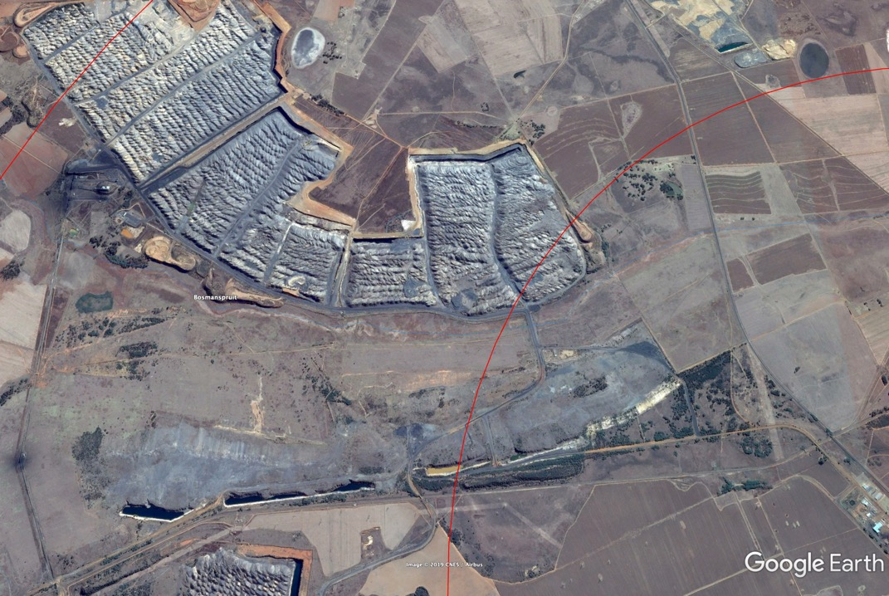

Slide 24
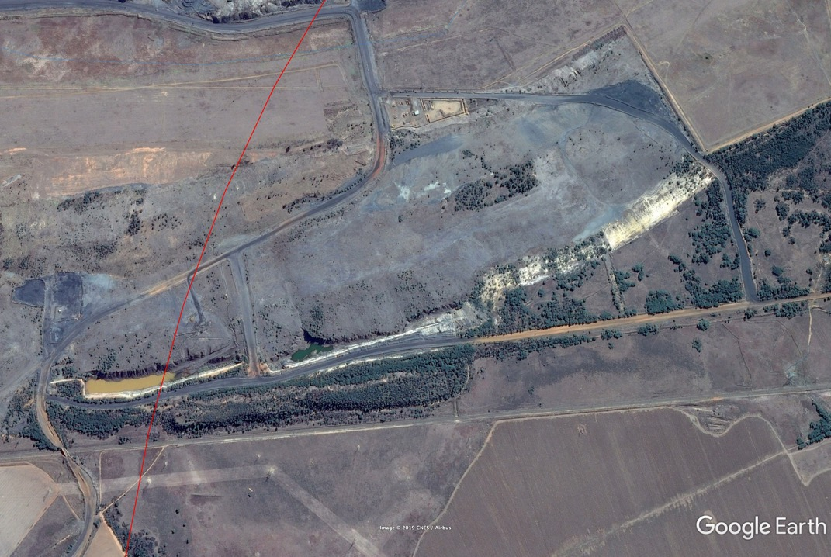

Slide 25
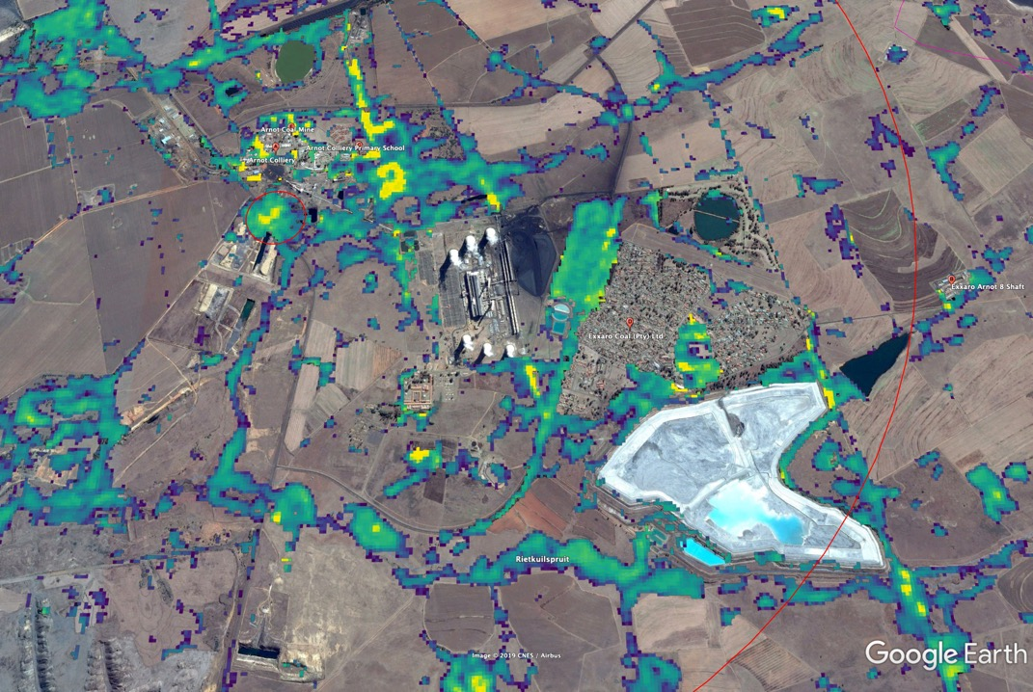

Slide 26
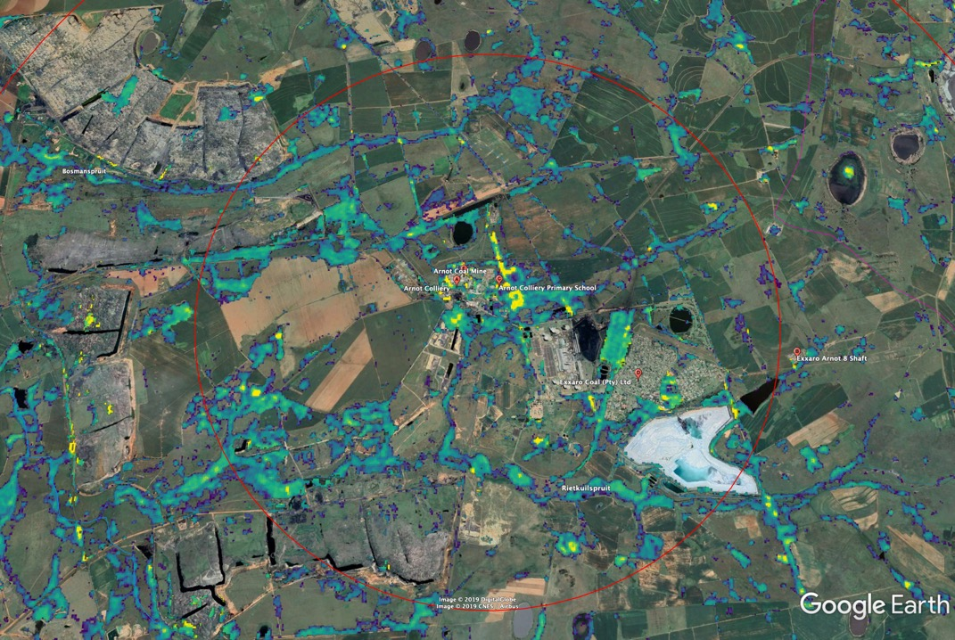
5Km Radius

Slide 27
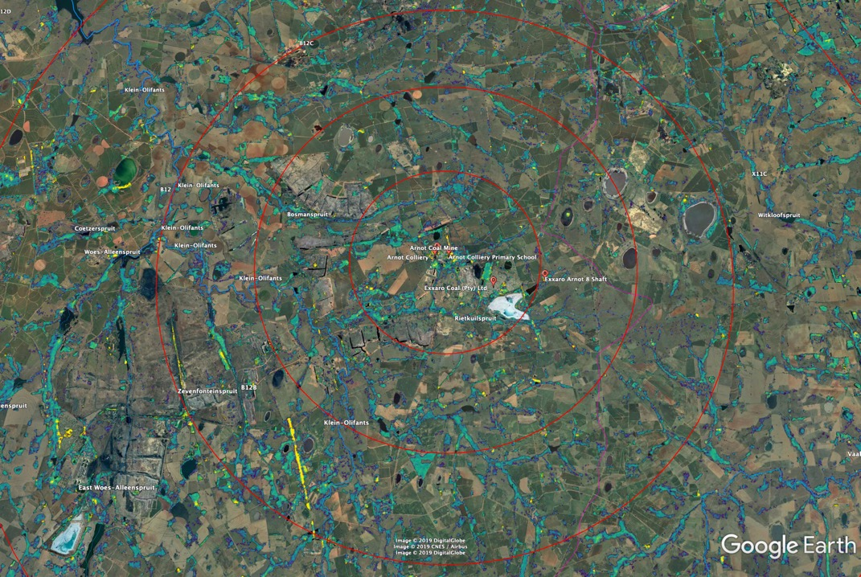
5Km Radius
10 Km Radius
15 Km Radius

Slide 28
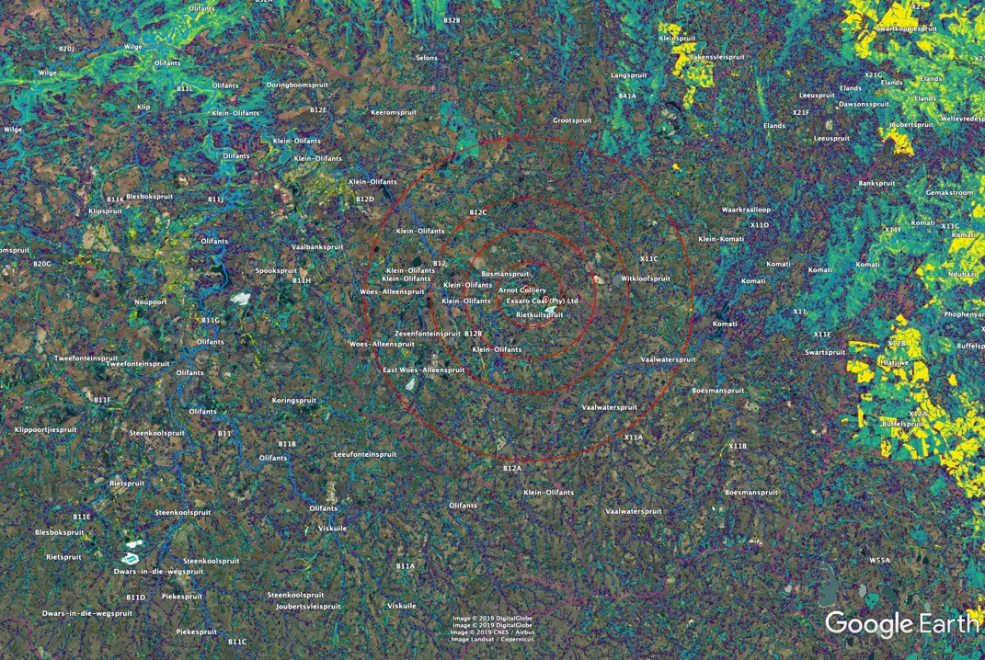
25 Km Radius

Slide 29
GBVC: Ecosystem Services & Land Restoration Value Chain
Harvest
On-Site
Value Add
Logistics
Off-site Value Add
Demand Links
All IAP Biomass
Clearing & Follow-up
Water Saving
Eradication
Employment
All Biomass
Erosion Control
Stewardship
Rangeland Mngt
Ecosystem Services
All Biomass
Pyrolysis
Transport
Biochar
Additive & Sequester
Poplar
Sort & Pack
Transport
‘Wood Wool’
Restoration Products

Slide 30
GBVC: Agricultural & Rural Livelihoods Value Chains
Harvest
On-Site
Value Add
Logistics
Off-site Value Add
Demand Links
All Biomass
Clearing
Land Management
Ranching / Agric
Food Value Chain
All Biomass
Pyrolysis & Prep
Transport
Agricultural Products
Agriculture
All Biomass
Clearing
Transport
Energy Needs
Local Use
All Biomass
Public Resources
Clearing Teams
Rural Economy
Rural Income

Slide 31
GBVC Raw Biomass Supply Chains: Examples
Harvest
On-Site
Value Add
Logistics
Off-site Value Add
Demand Links
All Biomass
Harvesting
Construction, Fencing
Rural Livelihoods
Timber Preparation
Eucaplypt (Red)
Logging
Transport
Milled Timber
Local & Export
Black Wattle
Lumber
Transport
Chip
Pulp & Paper
Gum
Lumber
Transport
Mill, Kiln, Manufacture
Education, Furniture

Slide 32
GBVC: I&AP Biomass to Energy Value Chains
Harvest
On-Site
Value Add
Logistics
Off-site Value Add
Demand Links
Various
Firewood Logs
Transport
Chop/Bundle/Bag
Domestic Firewood
All Biomass
Lumber
Transport
Chip
Heat / Steam
Black Wattle
Pyrolysis
Transport
Sort & Bag
Local & Intl Market
All Biomass
Biomass Value Add
Transport
Pellets
Energy / Steam

Slide 33
Other Invasive Biomass Opportunities
Packaging
Palettes
Mine Support Timber
Timber (NCT)
Bio Jet Fuel

Slide 34
Other Invasive Biomass Opportunities
Biochar, Compost, Hydrosoils
Erosion Control
Agricultural Mulch
Oom Braam se Cow Chow
Fireproof Building material

Slide 35
Financial reporting and support process
Planned – currently unfunded
Mentorship programme
Key principle: Owner remains accountable and involved in financial process
1.Xxx
2.Xxx
3.Xxx
4.xxx
Quarterly Accountant oversight:
Financial Report
Assessment
Feedback call to Bookkeeper for development recommendations
Data analysed for general errors and development areas identified
Financial coaching refresher courses delivered locally ad hoc, built from insights from the reporting process (delivered within the Peer Mentor session framework)
1.Xxx
2.Xxx
3.Xxx
4.xxx
1.Xxx
2.Xxx
3.Xxx
4.xxx
Month 1
Bookkeeper: process books
Complete template with SME
SME uploads template
Month 2
Bookkeeper: process books
Complete template with SME
SME uploads template
Month 3
Bookkeeper: process books
Complete template with SME
SME uploads template
‘Special’ bookkeepers sourced – retired Accountancy teachers? Need developmental bias

