Slide 1
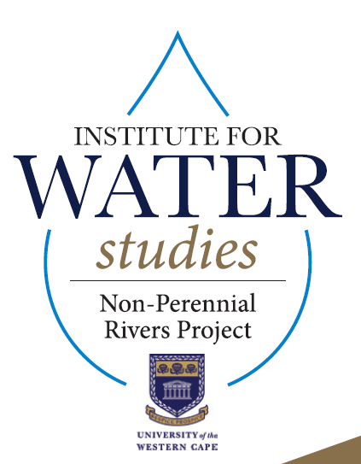
Institute for Water Studies
University of the Western Cape
Water in the Overberg: The intricate interplay between groundwater and surface water
25 Sep 2019
Jaco Nel, Dominic Mazvimavi, Vincent Banda, Aneeqah Cornelius

Slide 2
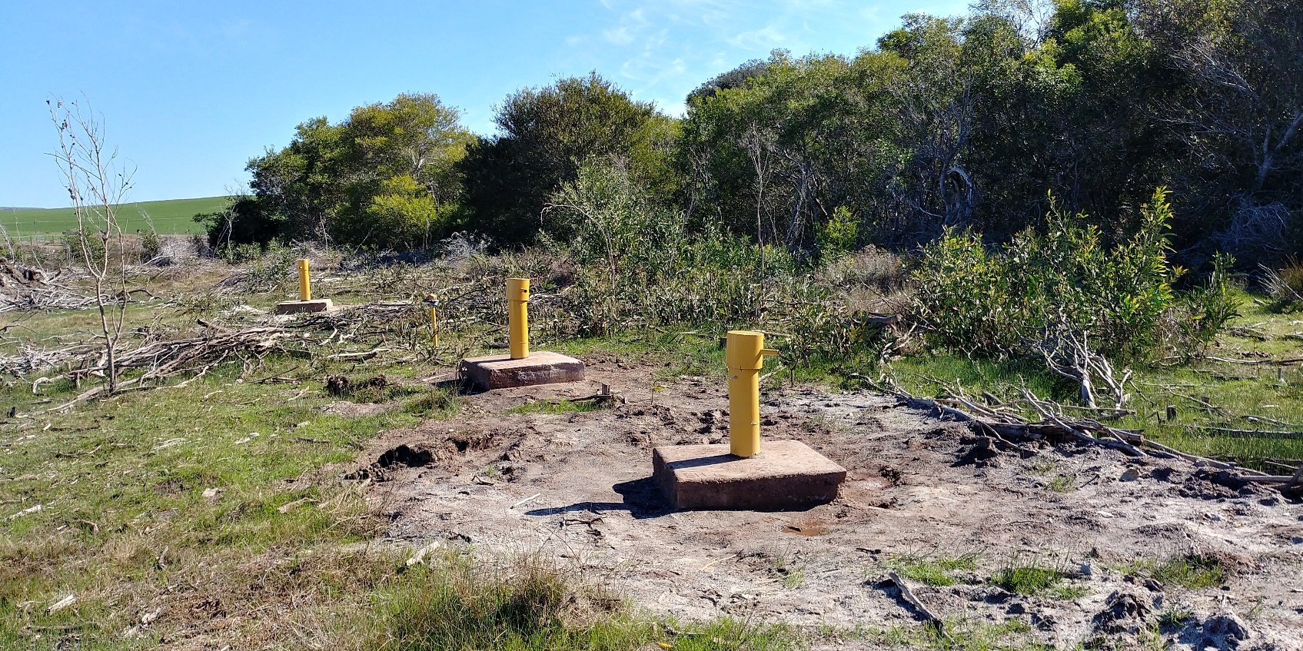
Opportunity to make a difference
Living Laboratory
Students studying and contributing to a real life catchment
Improve data collection to understand system and provide informed management options.
Agriculture – land use, water availability and quality
Social - water quality, eco tourism, birding
Conservation – Protected areas and SANParks – ecosystem functioning

Slide 3
Research funding available for
Improved management of non-perennial rivers – SW, GW, Geomorphic, Quality, Fauna, Aquatic components.
  Improved data collection
  Conceptual models of interactions
  Assist regulators to manage non-perennial river systems.
To improve understanding of flow of water through Nuwejaars catchment – fresh water in upper catchment – becoming more saline towards the lower catchment.
  How much water ?
  What quality ?
  How do we ensure sustainability?

Slide 4
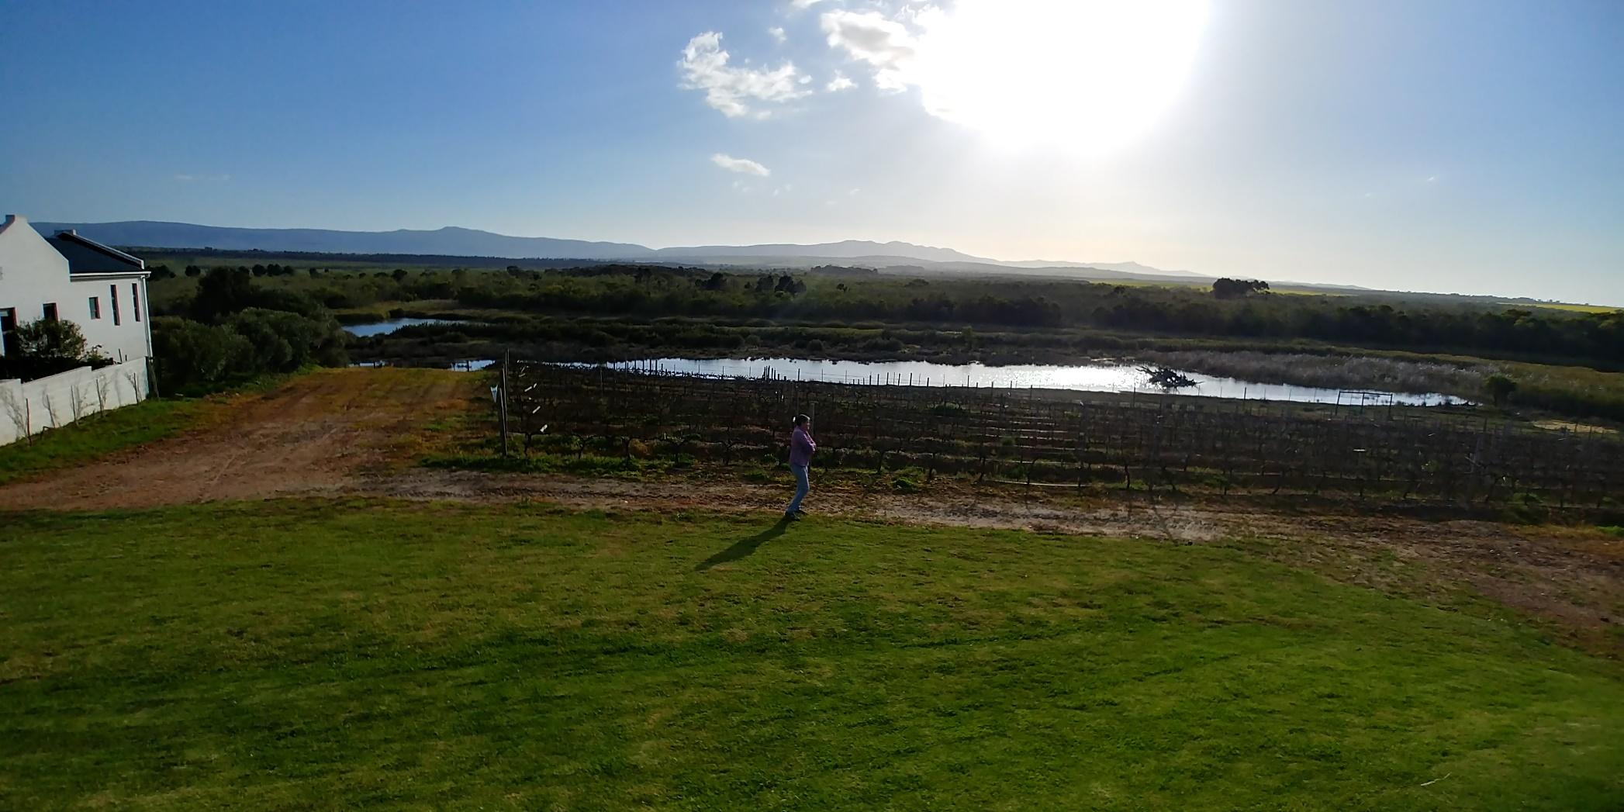
What role of groundwater in water availability and quality ?

Slide 5
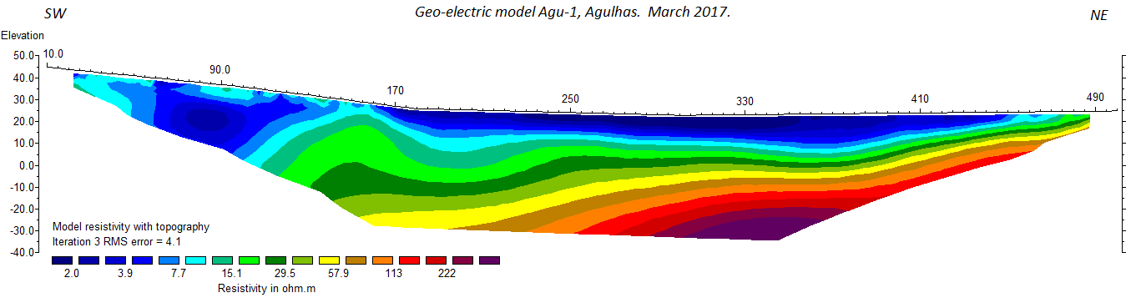
Electrical Resistivity Geophysical Survey

Slide 6
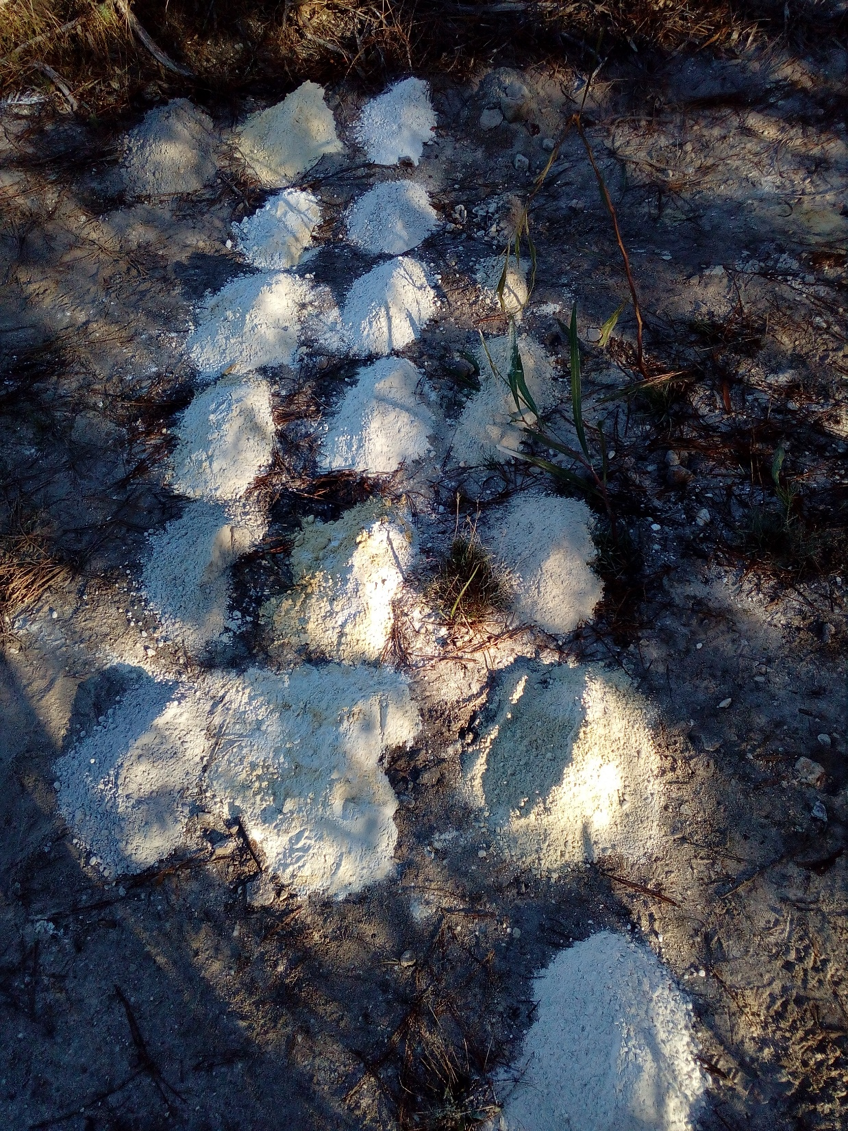
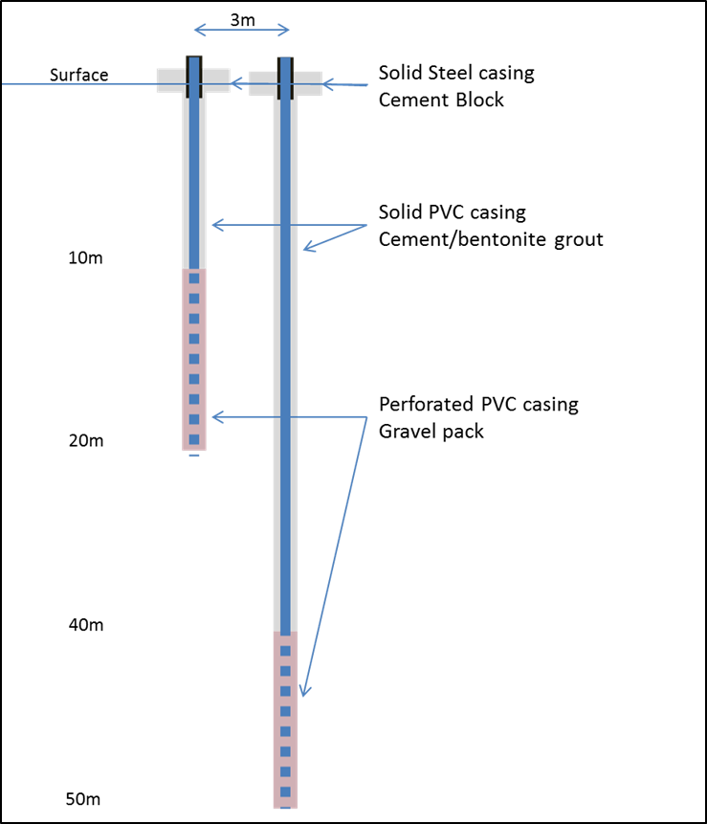
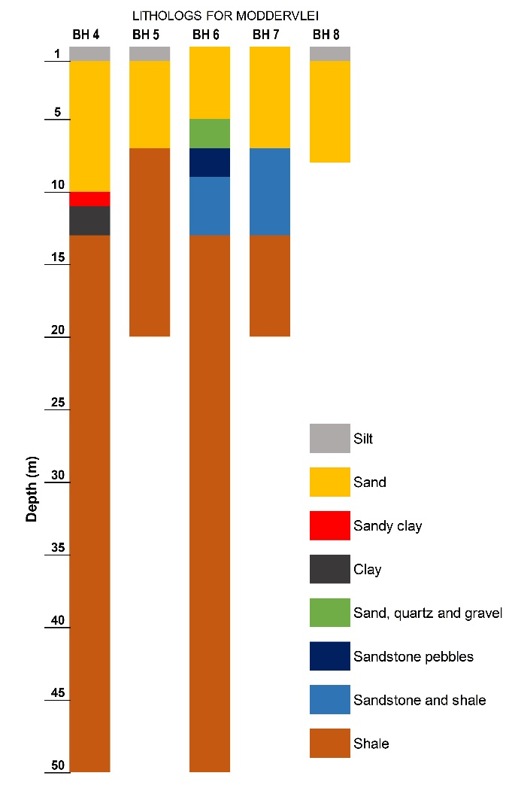
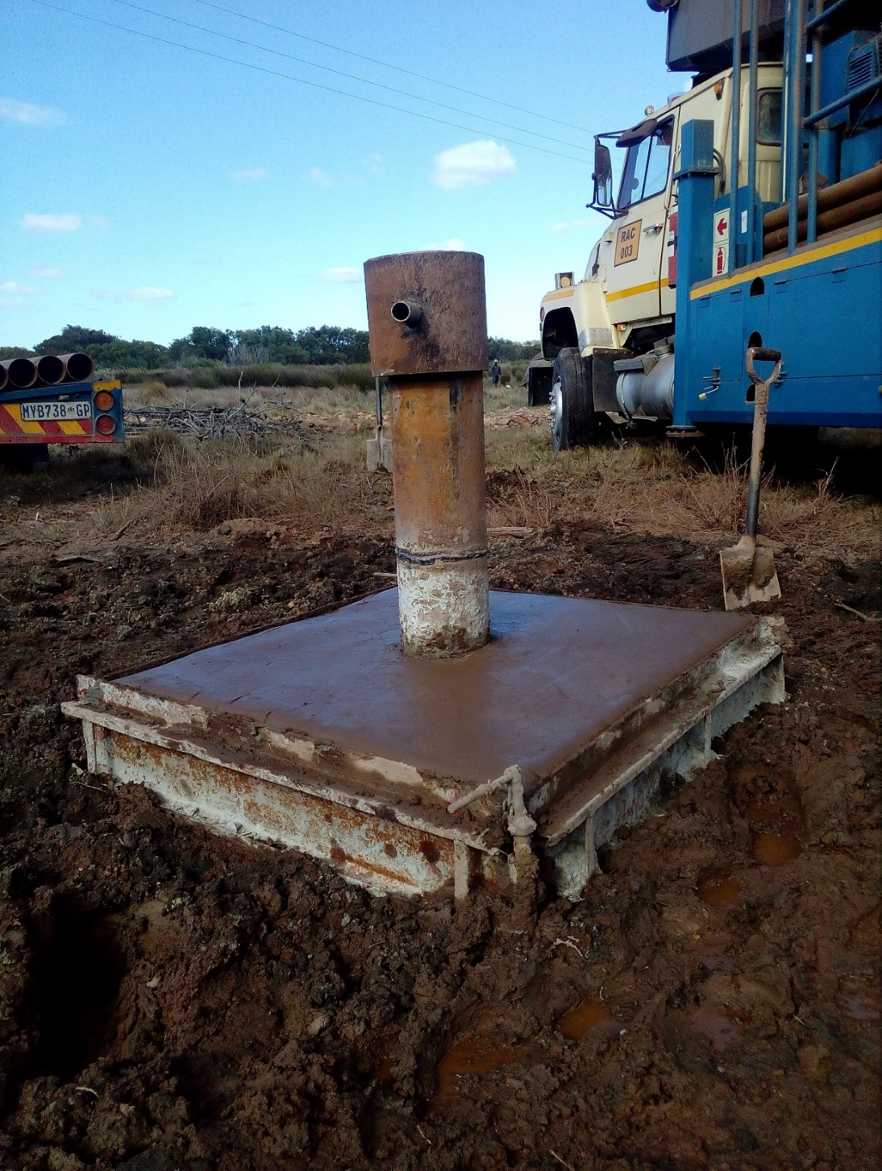
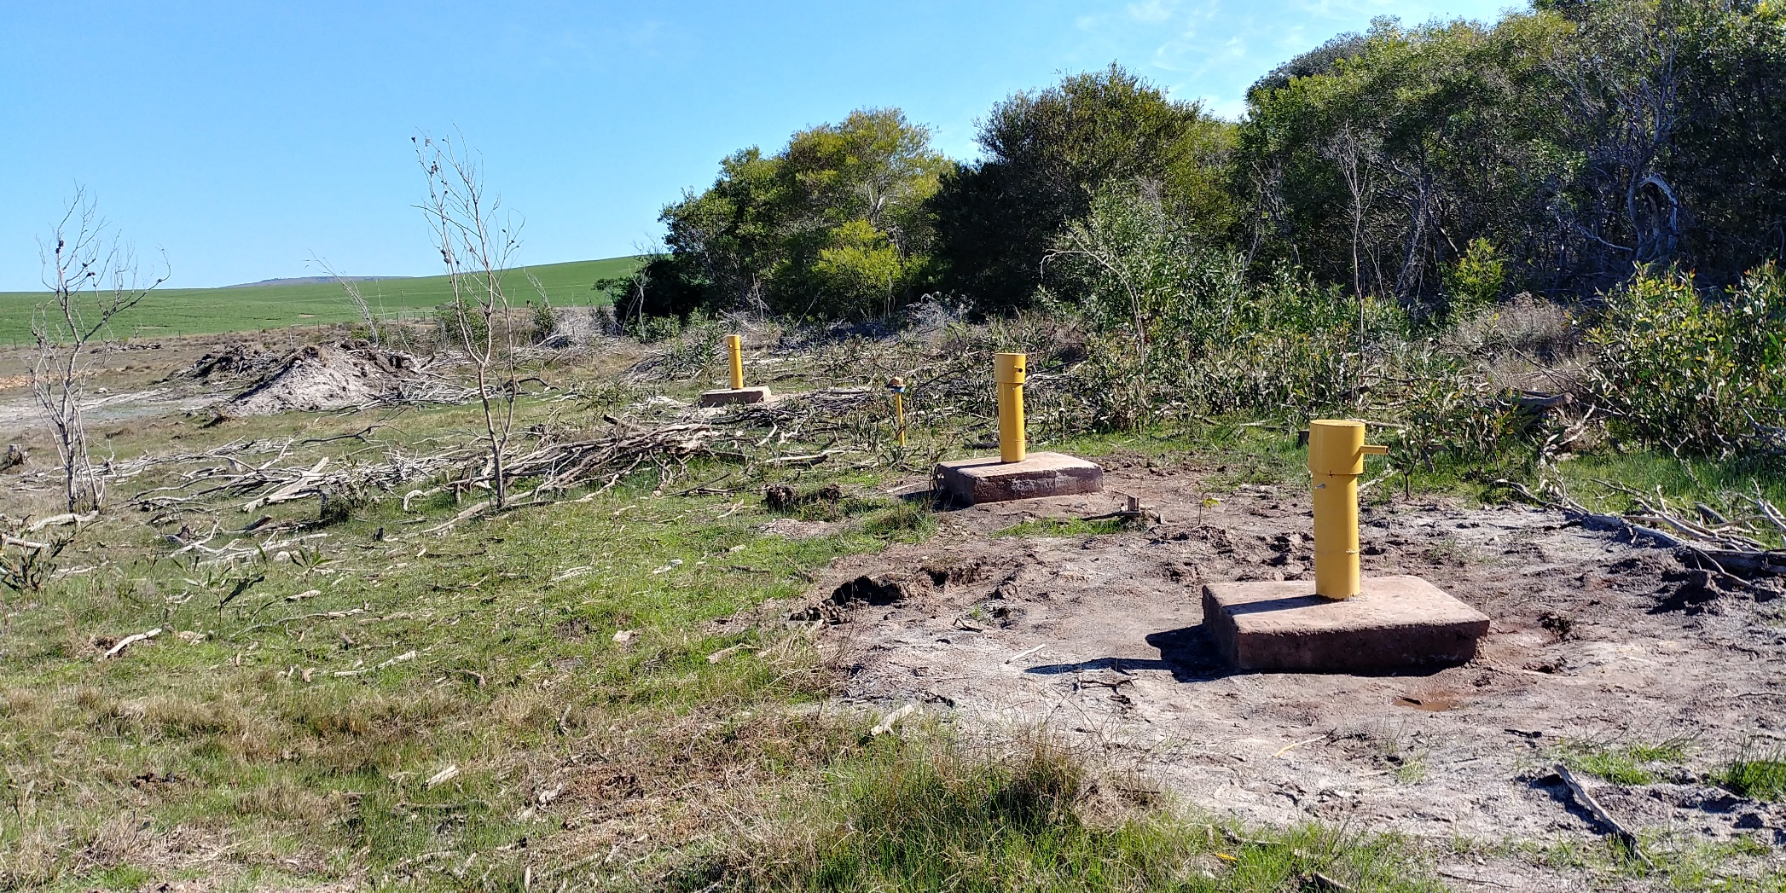

Slide 7
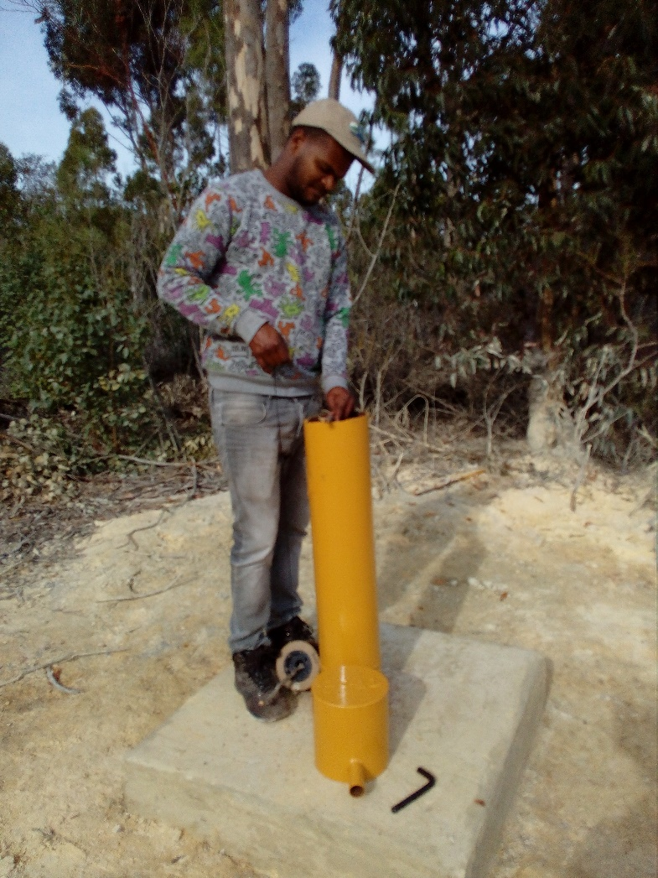
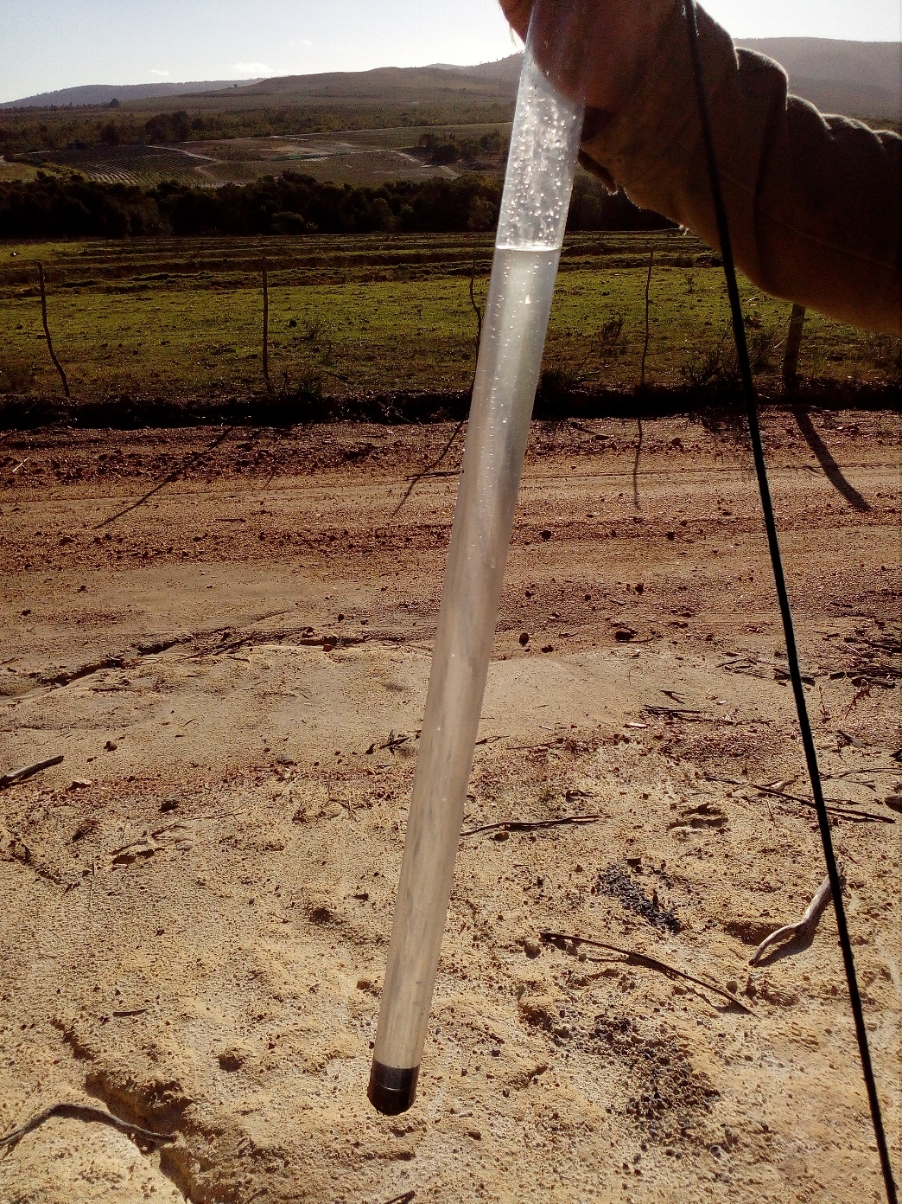
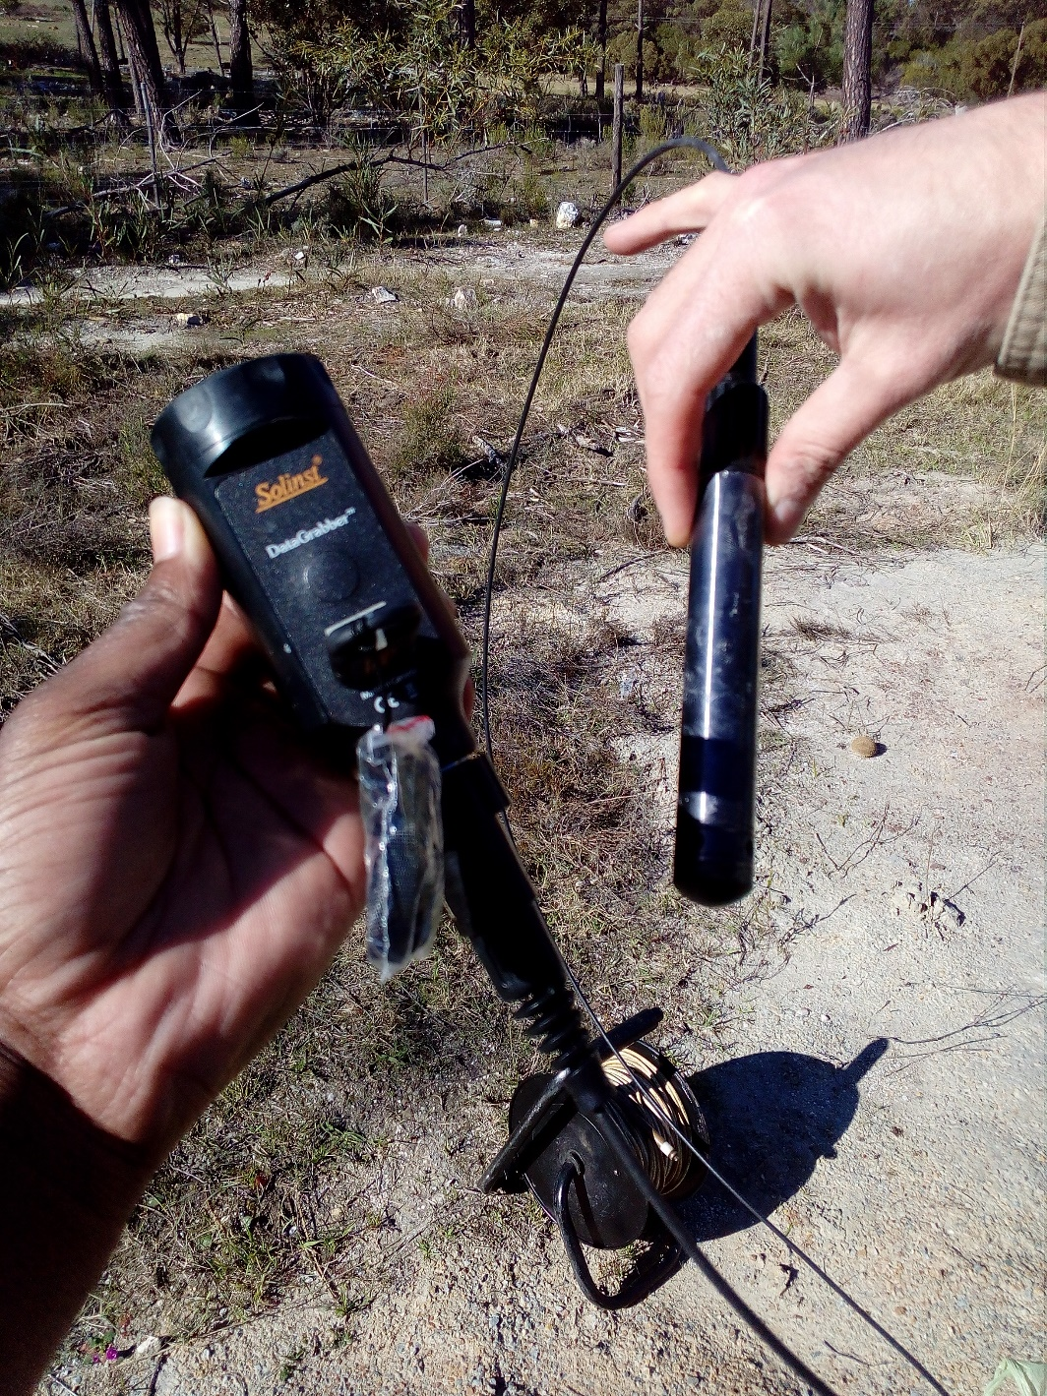

Slide 8
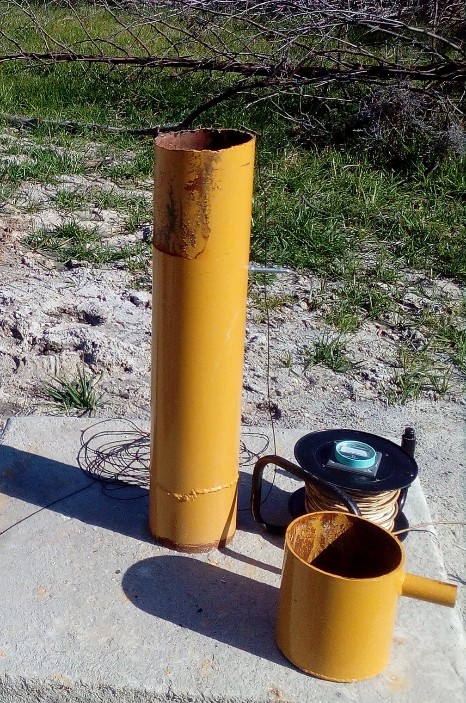
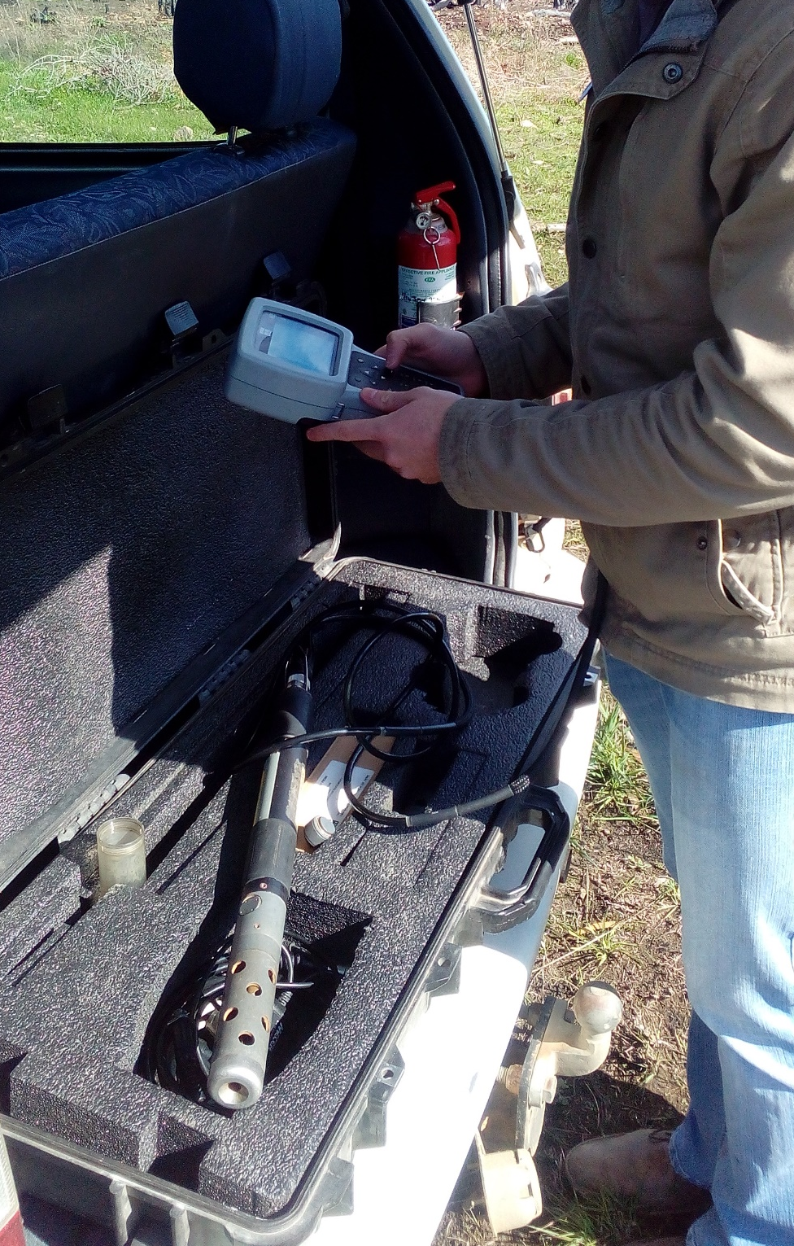

Slide 9
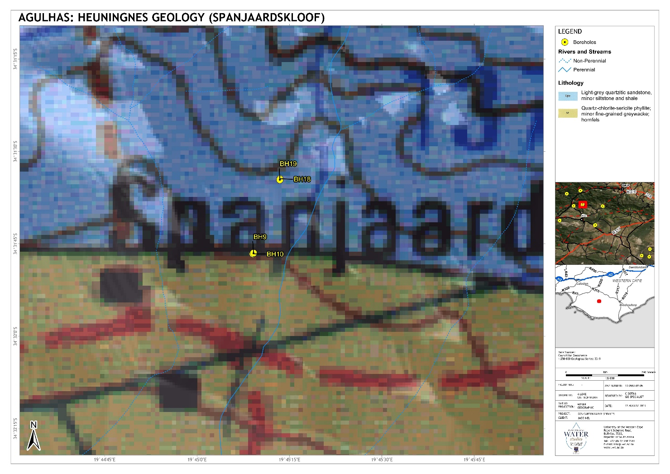
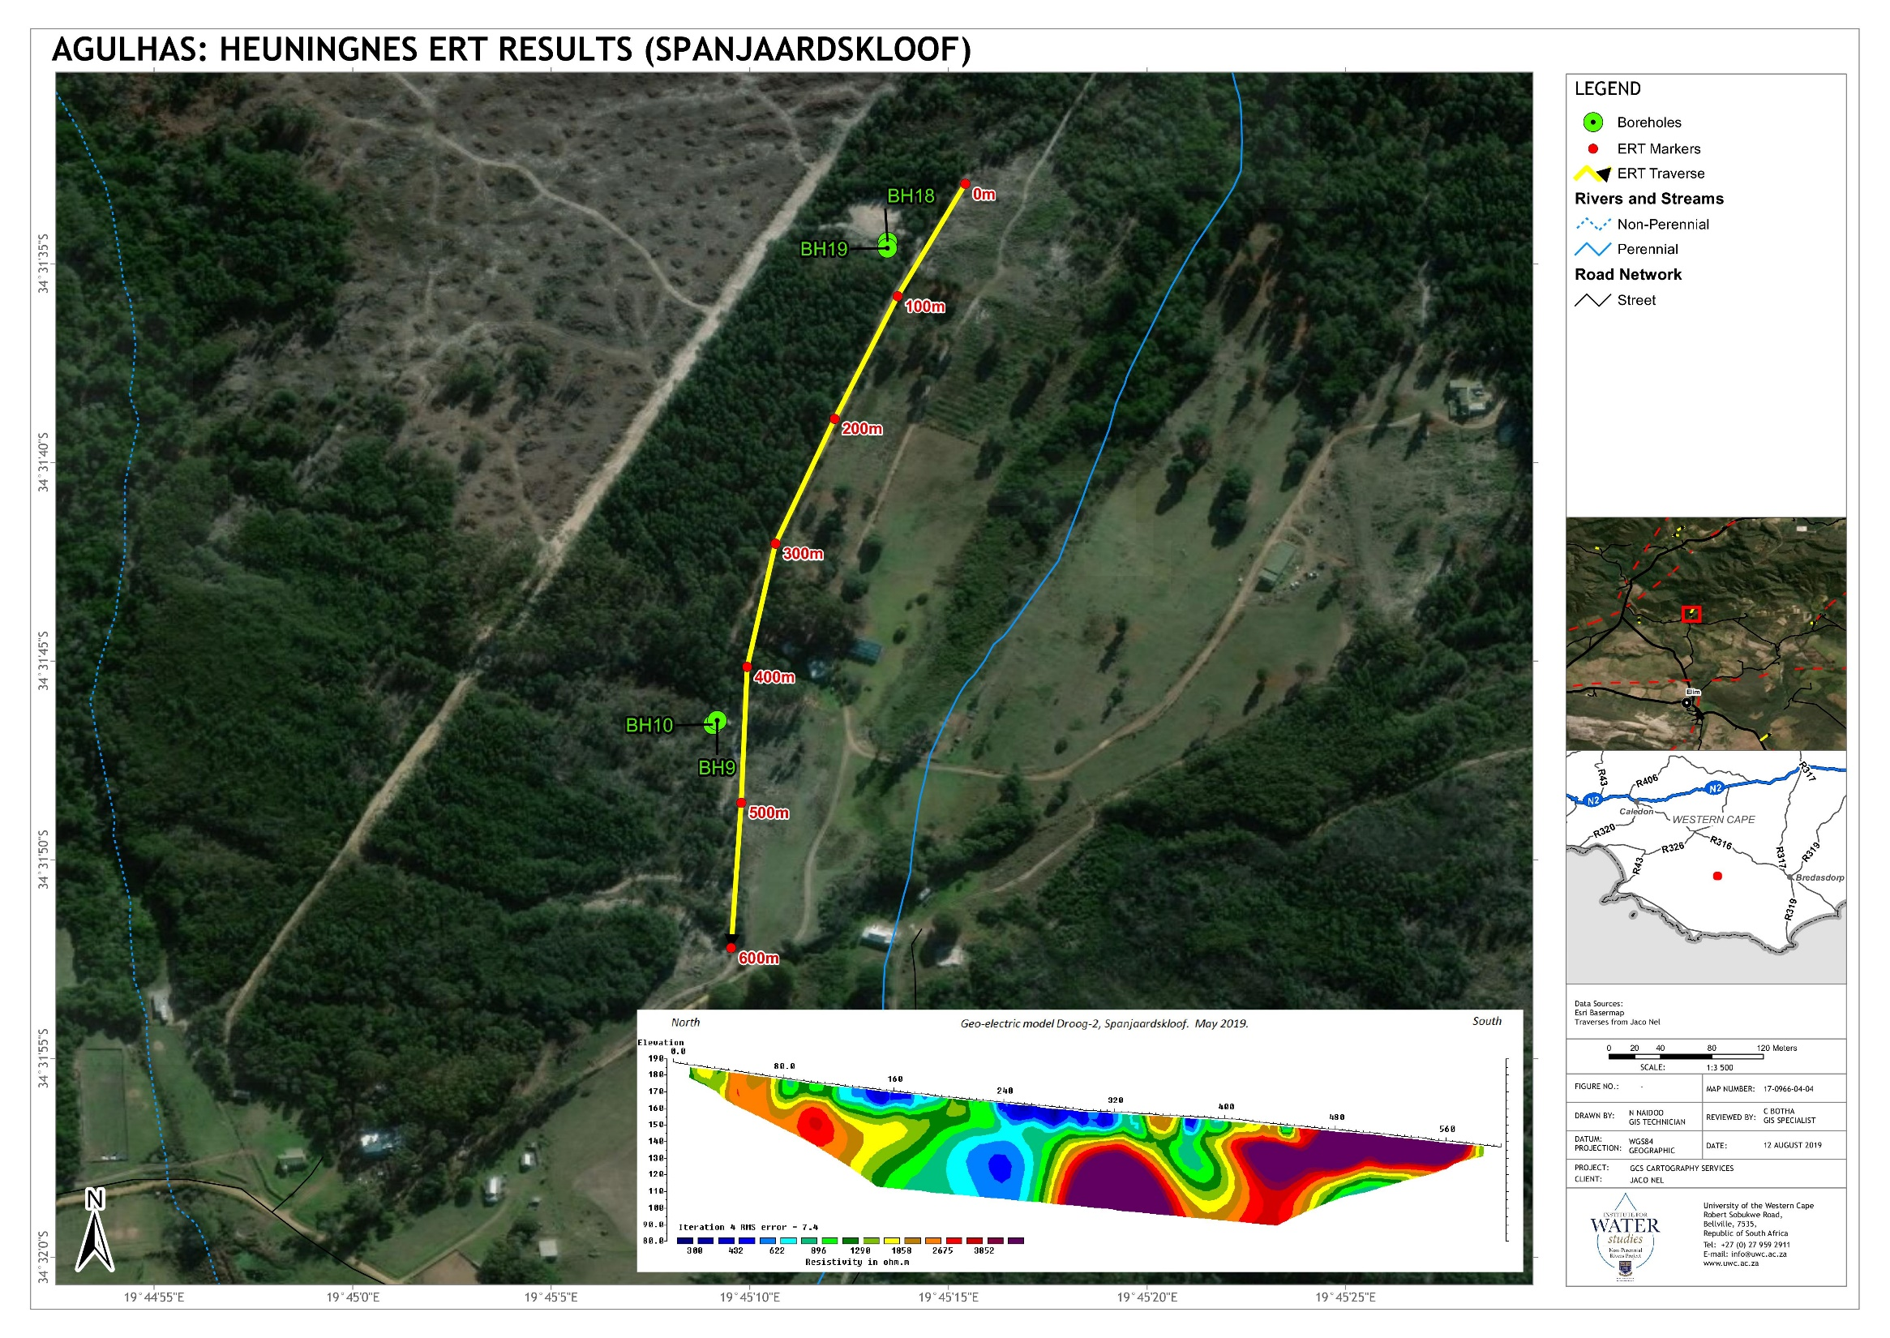
Local Investigations

Slide 10
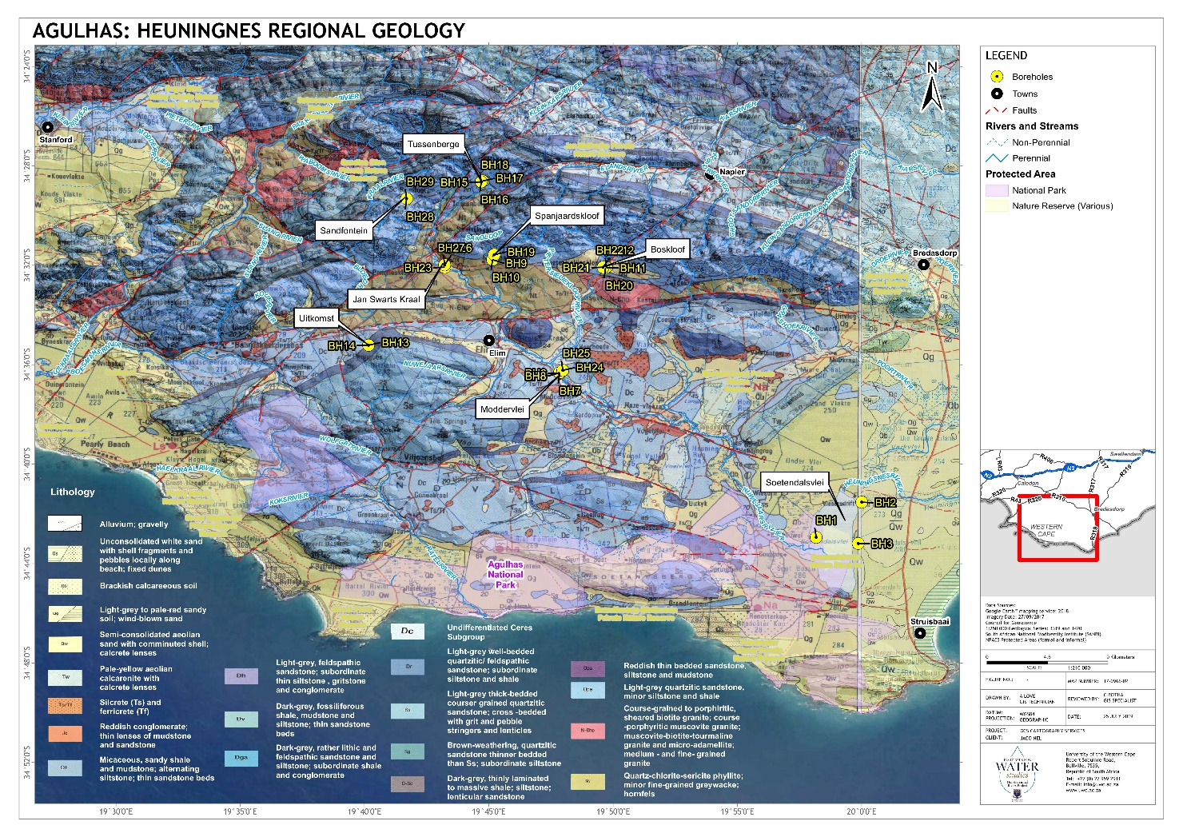
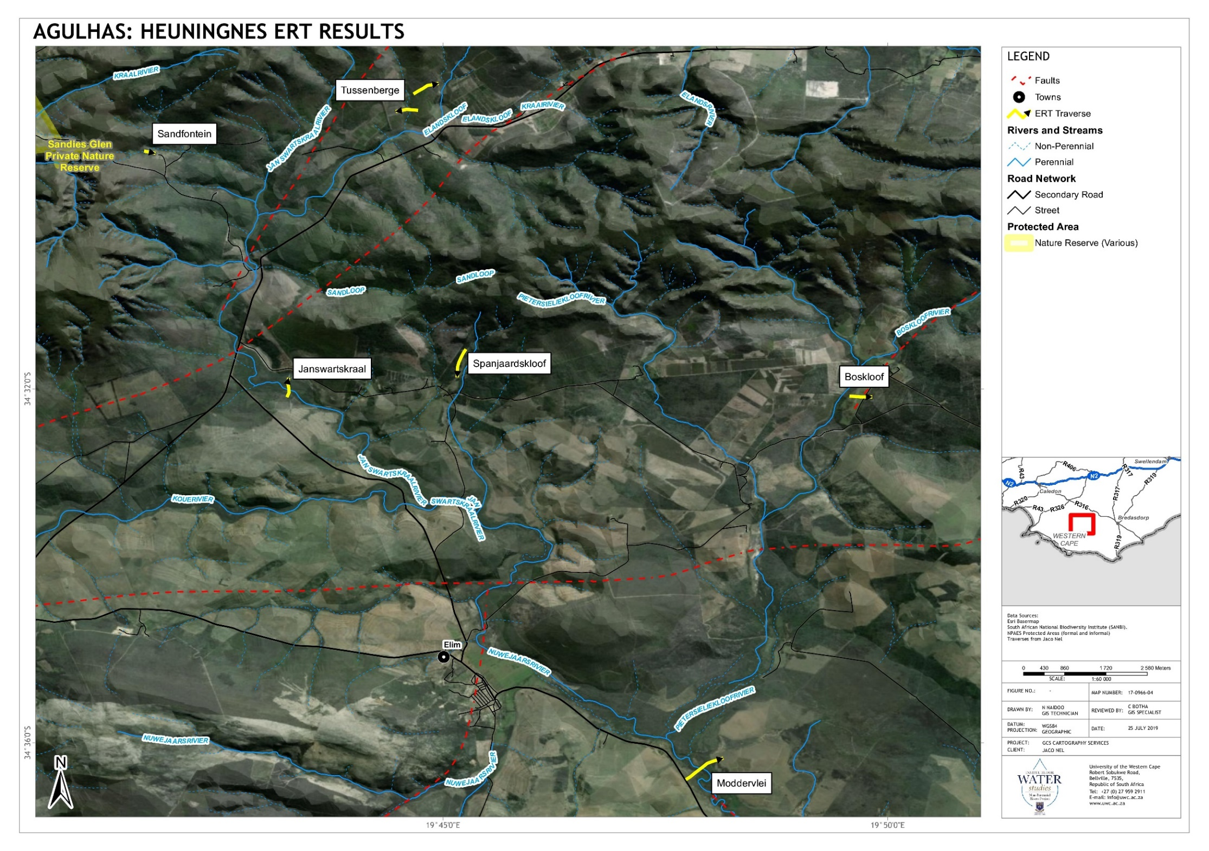
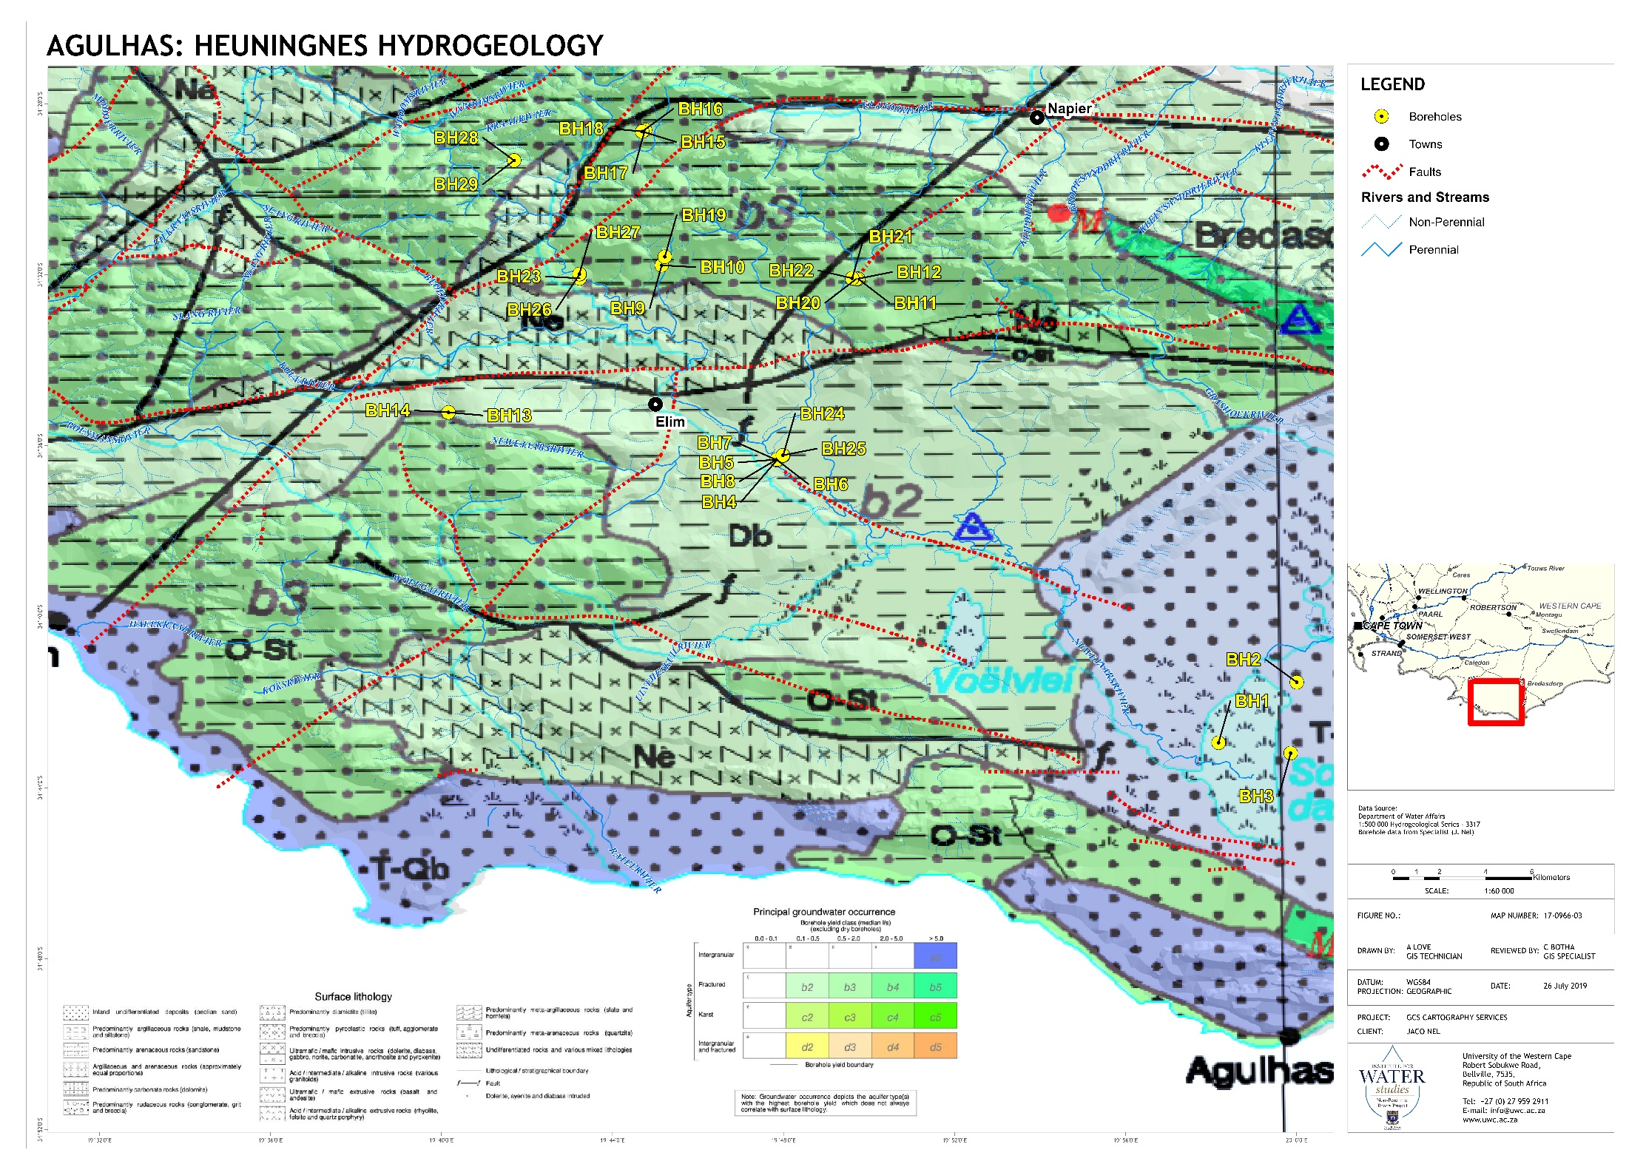
Larger area coverage

Slide 11
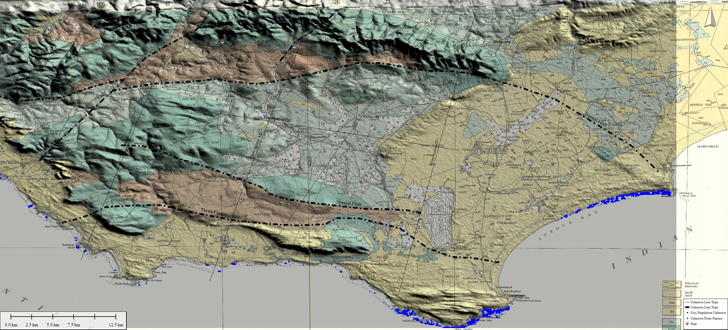
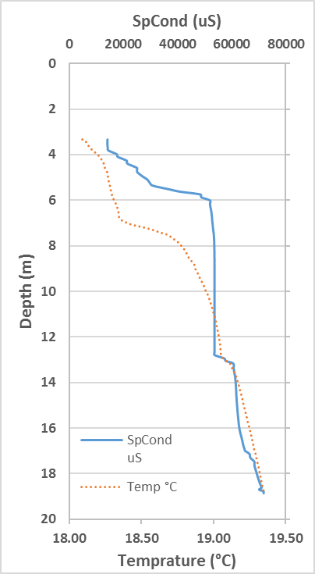
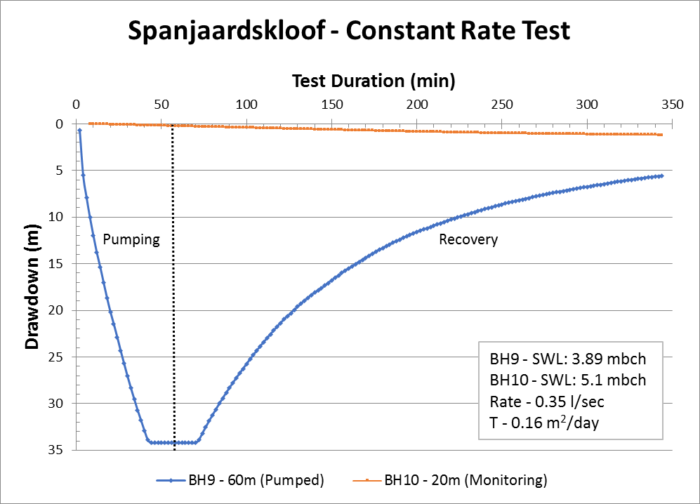
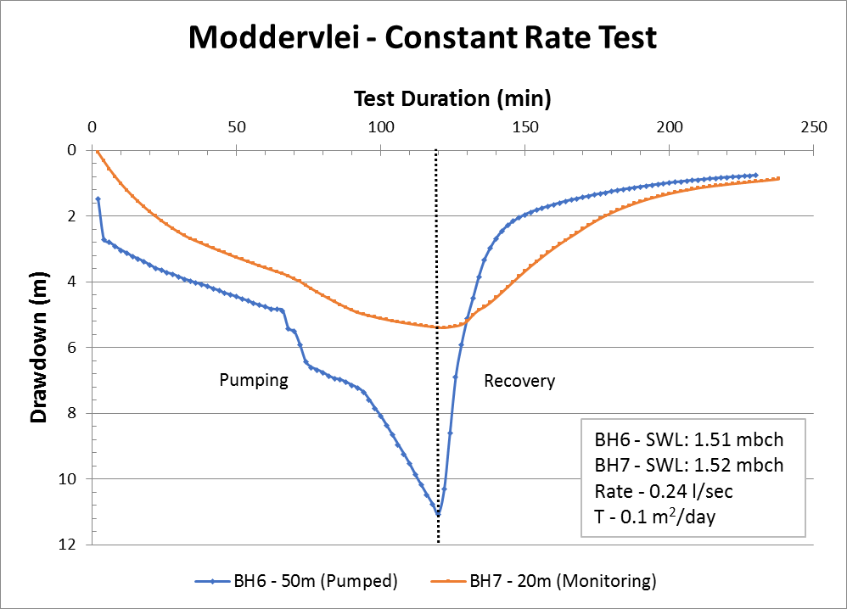
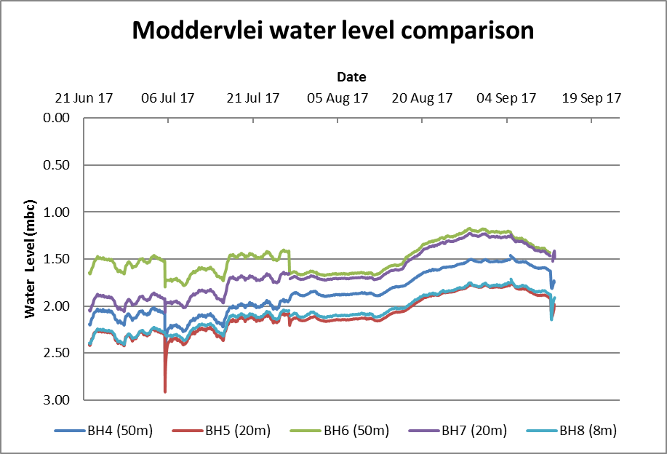
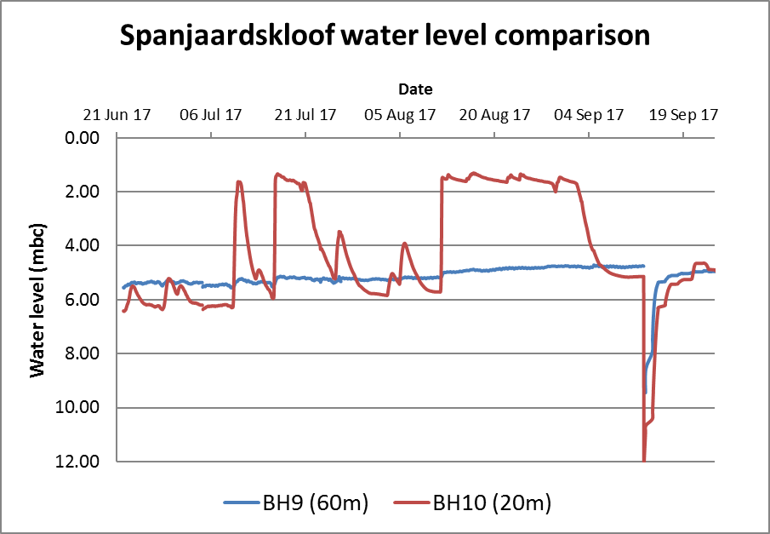
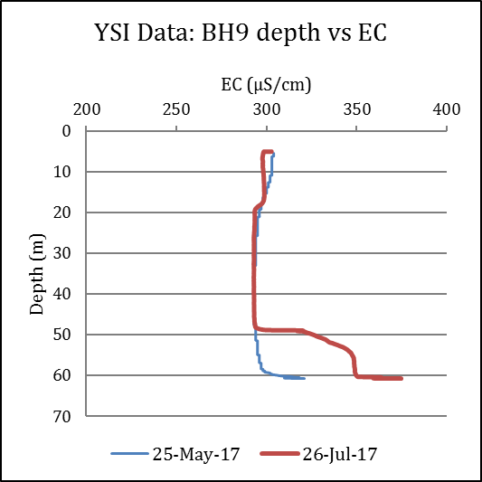
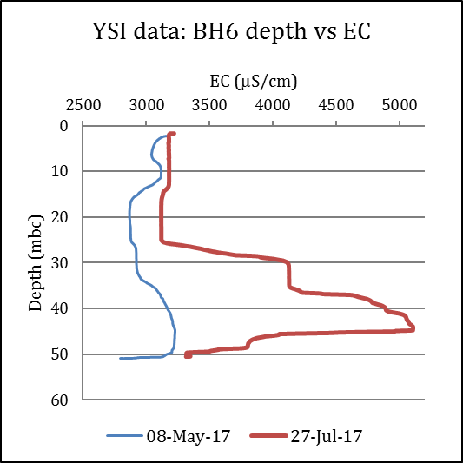
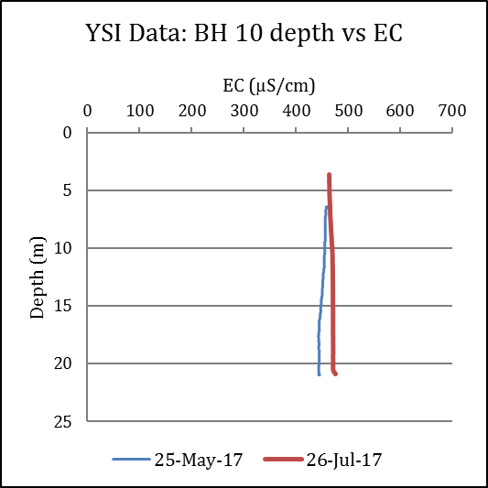
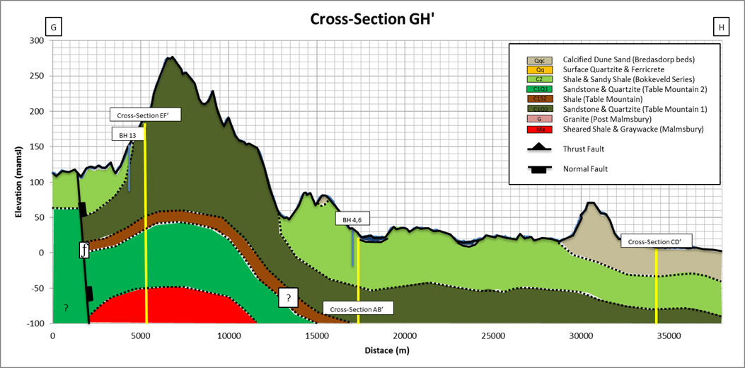
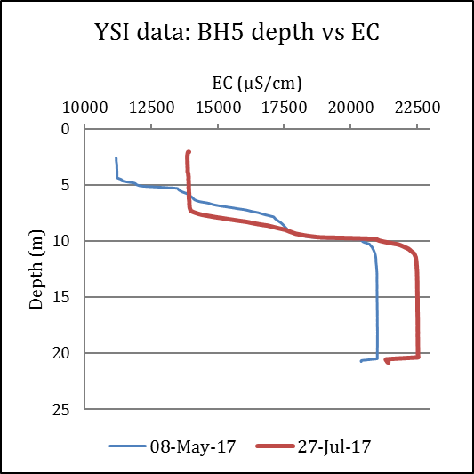
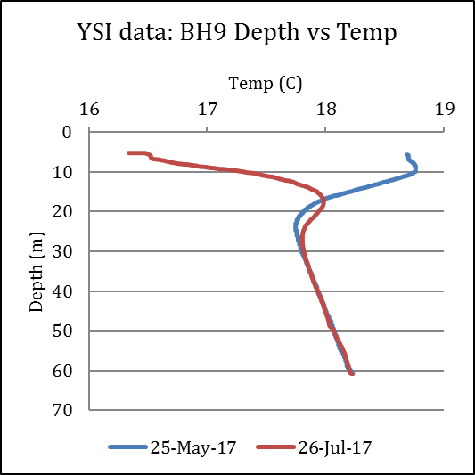
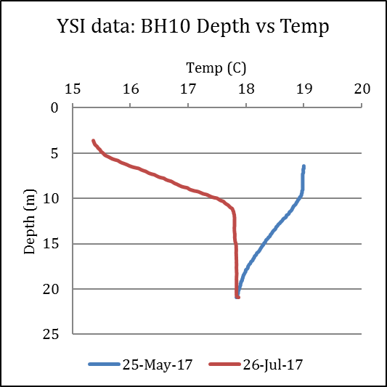
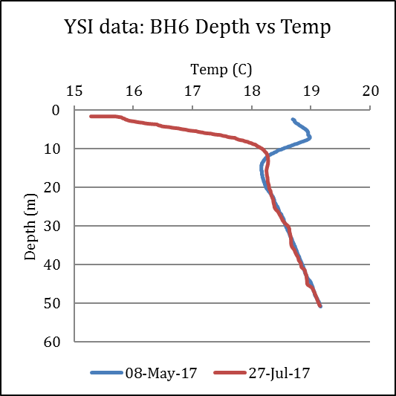
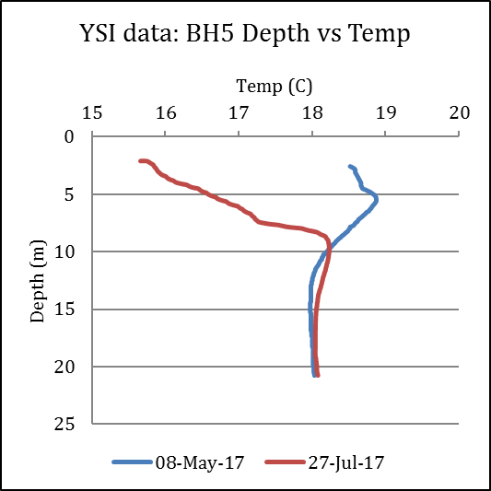
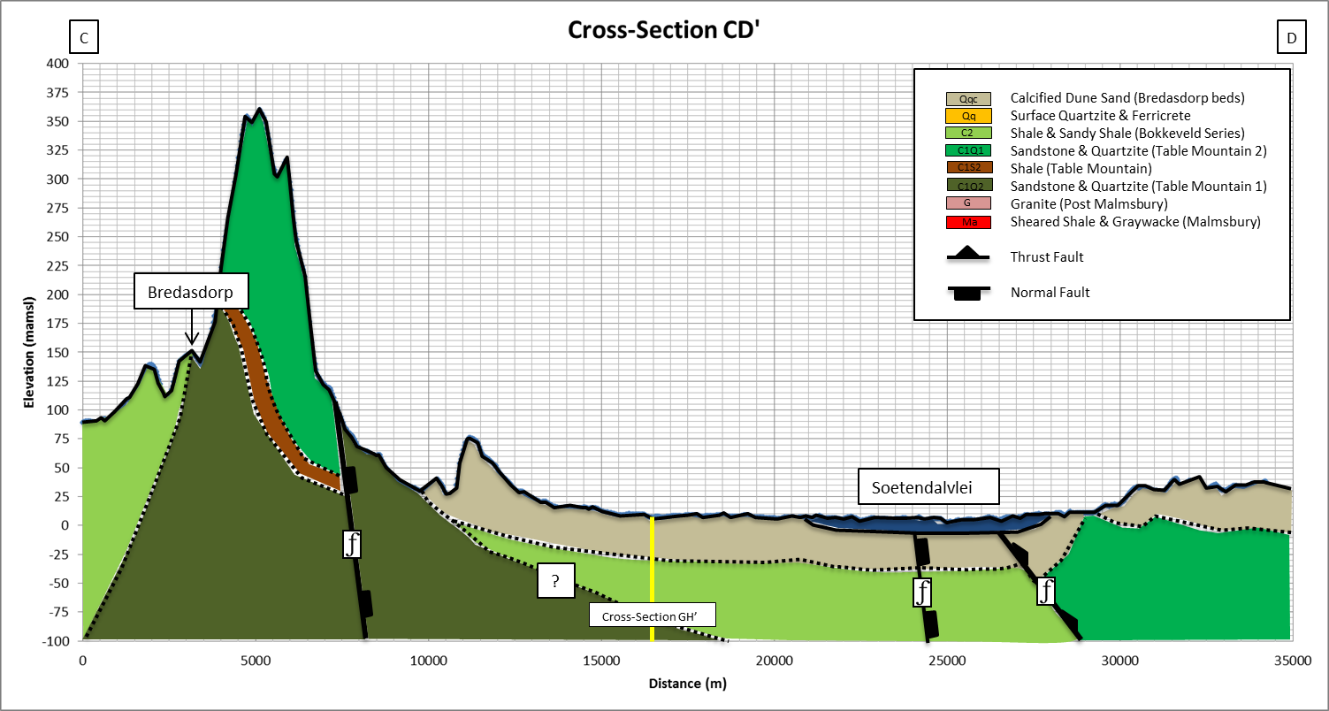
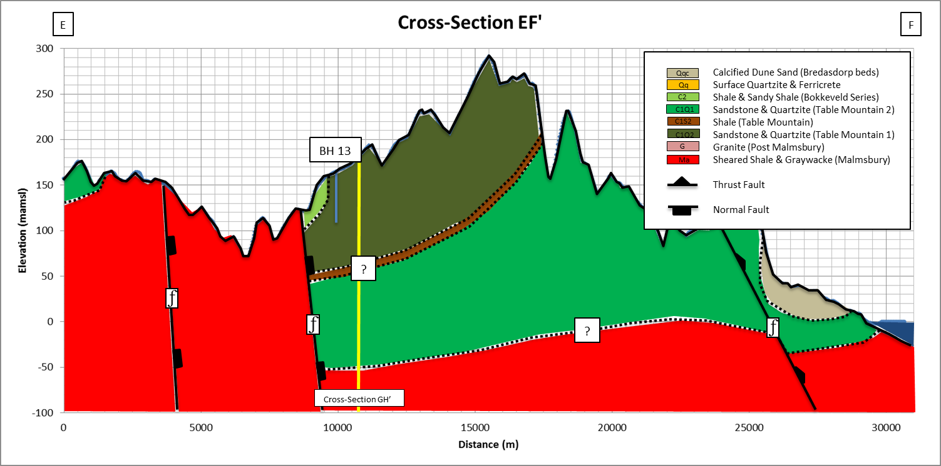
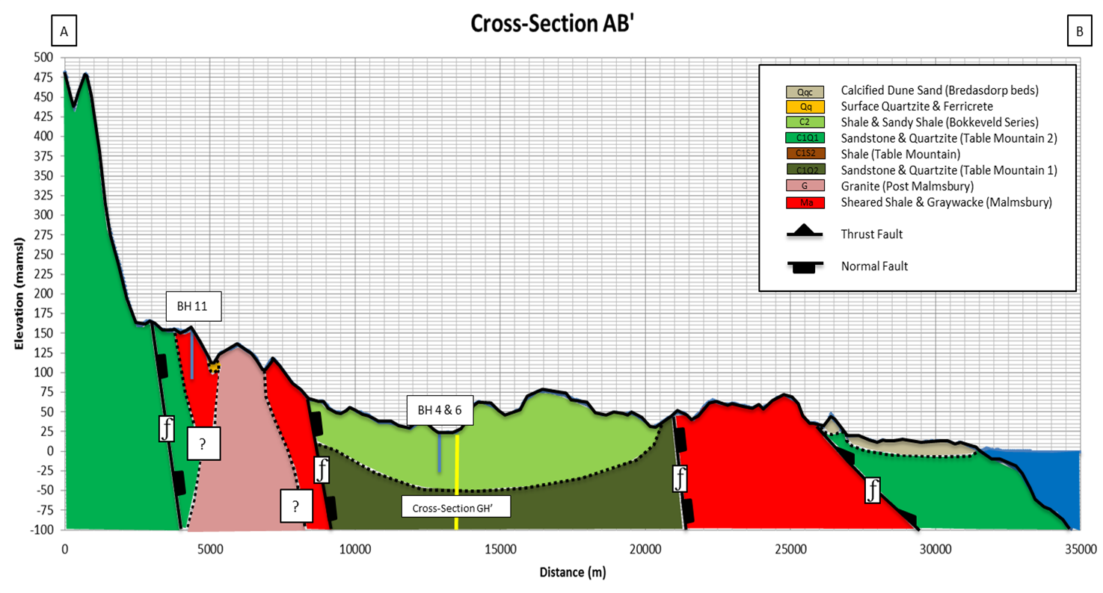
E
A
C
TMG Peninsula
Spanjaardskloof
Bredasdorp
Granite
Malmesbury
G
Elim
Moddervlei
Bokkeveld Shale
TMG Goudini
H
Conceptual Understanding
Malmesbury
SANParks
Bredasdorp sand
F
B
Struisbaai
D

Slide 12
Ongoing research
Rainfall – SW – GW – Tree interactions
Water quality changes through the seasons
Temperature, water quality and isotope studies

Slide 13
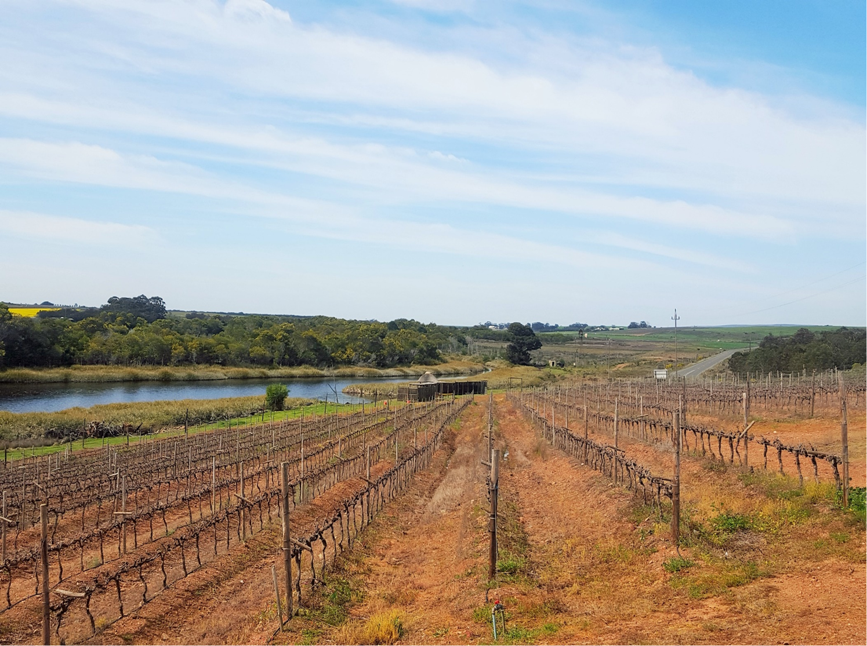
Thank you
jmnel@uwc.ac.za

